Slide 1
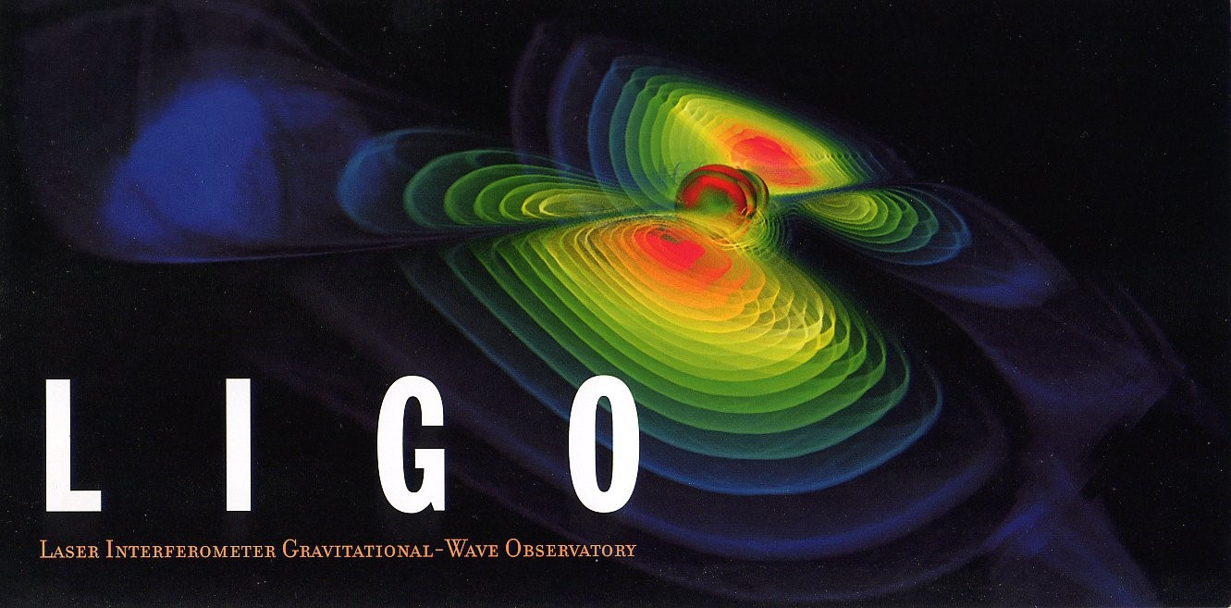
Adaptive Mode Matching in Advanced LIGO and Beyond
Thomas Vo
Syracuse University
March 26th, 2019
Notes:
Hello, my name is Thomas Vo and I want to thank everyone for coming, especially my committee members who have taken time out of their busy schedule to do extra paperwork on my behalf.
LIGO was built with the purpose of exploring some of the deepest mysteries of the universe. My goal from day one has to advance that purpose by solving smaller problems each day, so it is my joy and honor to have worked in this collaboration which re-kindled my love for science.

Slide 2
Outline
LIGO Intro
Gravitational Waves
Advanced LIGO
High Power Operation
Problems -> Point absorbers
Possible solutions
Road to the next observing run (O3) for Hanford….
April 1st, 2019
Notes:
I will do a quick LIGO introduction, with some words on Gravitational Waves and how LIGO detects them
Then I’ll talk about how high power operation fits into the scheme of getting higher power
Then I’ll talk about only one of the potential pitfalls of

Slide 3
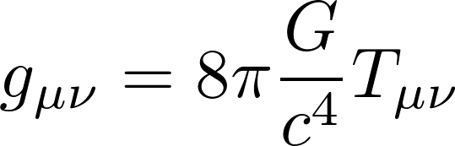
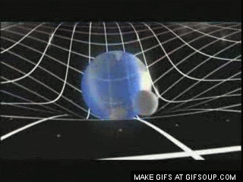
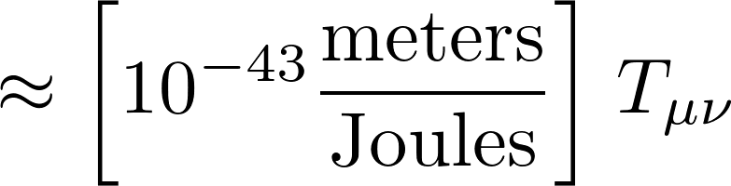
Space-Time Curvature
The left side is curvature, the right side is mass-energy, with a very tiny conversion factor relating them.
“ Mass tells space-time how to curve and space-time tells mass how to move.” – John Wheeler
Notes:
The left side is curvature in 1/m^2 the right side is energy density that curves space-time. After crunching the numbers we see a small conversion factor. And I think John Wheeler said it best:

Slide 4
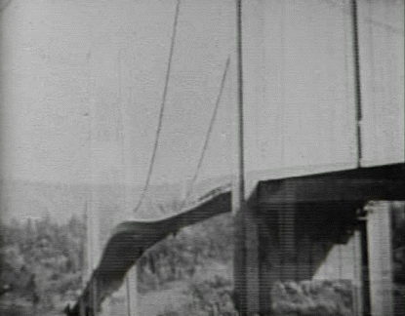
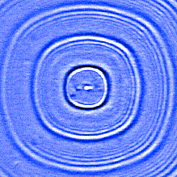
Gravitational Waves
GWs are ripples in the fabric of space time!
Notes:
A droplet of water causing the waves on a puddle
I actually like to think of GWs as waves in concrete, normally flat, still and stiff but under the right conditions, waves can occur

Slide 5
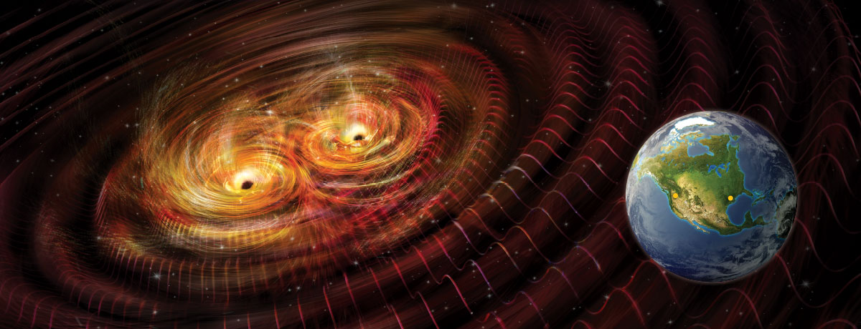
Gravitational Waves
Notes:
It requires black holes and other astrophysical objects that have enough mass density to create

Slide 6

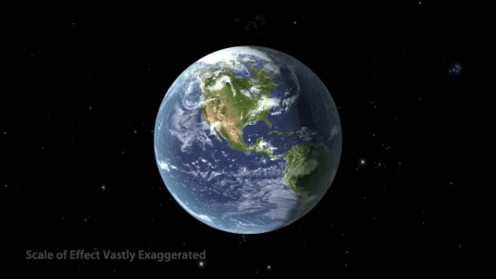
Gravitational Waves
This is how they affect free floating particle.

Slide 7
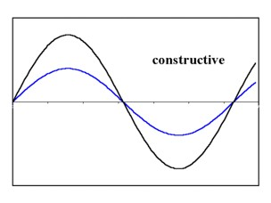
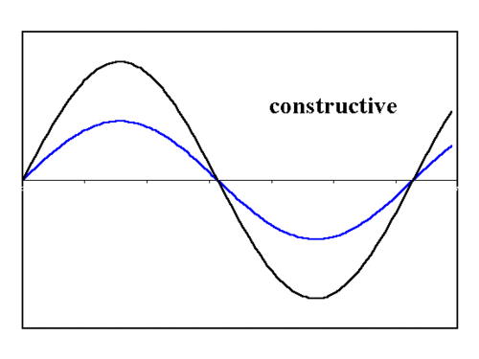
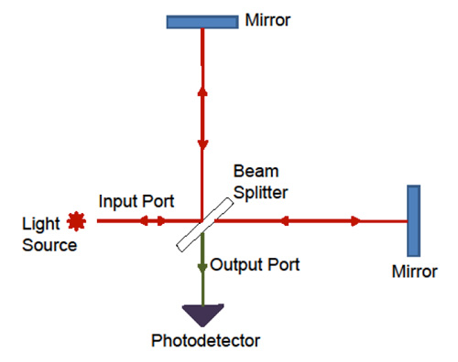

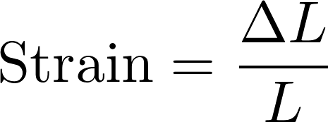

Basic Michelson Interferometer
L
Differential Arm Motion!
L
Notes:
A laser enters from the left and is split by a 50/50 beam splitter, and goes down both arms and back…as light propagates through space, it gains phase (which depends on the lengths). The light recombines at the BS and depending on the phase difference, the light will either destructively or constructively interfere.

Slide 8
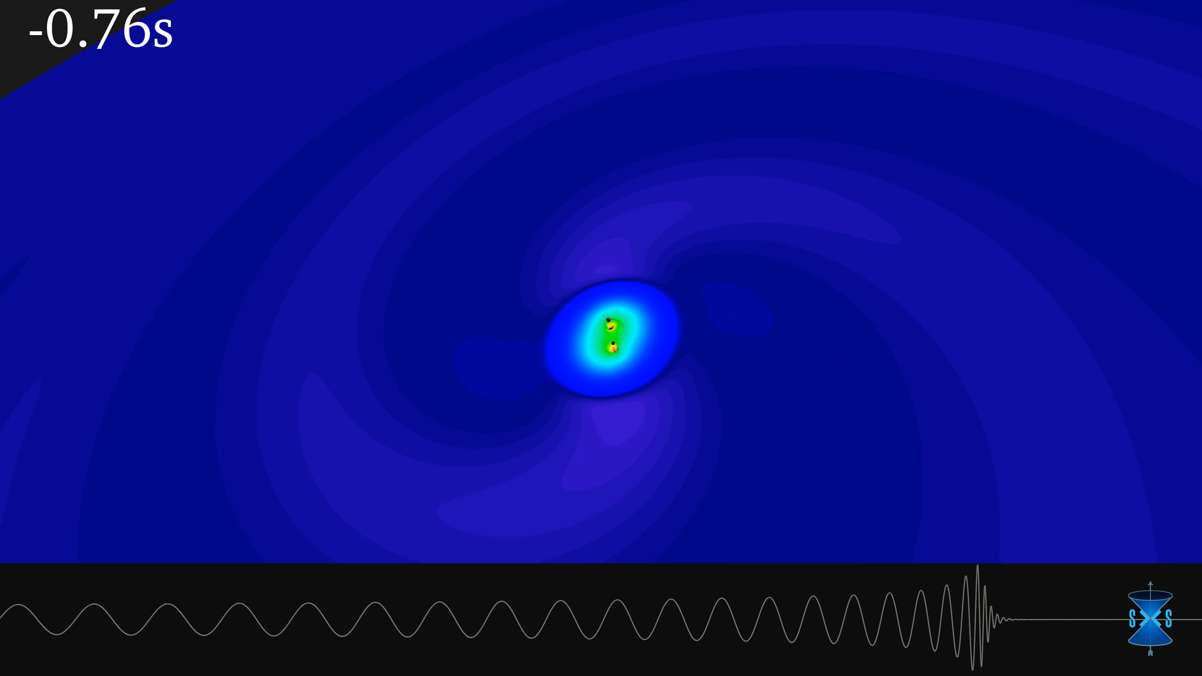
1.3 Billion Light Years Away…
Notes:
Meanwhile on earth, we were just beginning multi-celluar life.

Slide 9
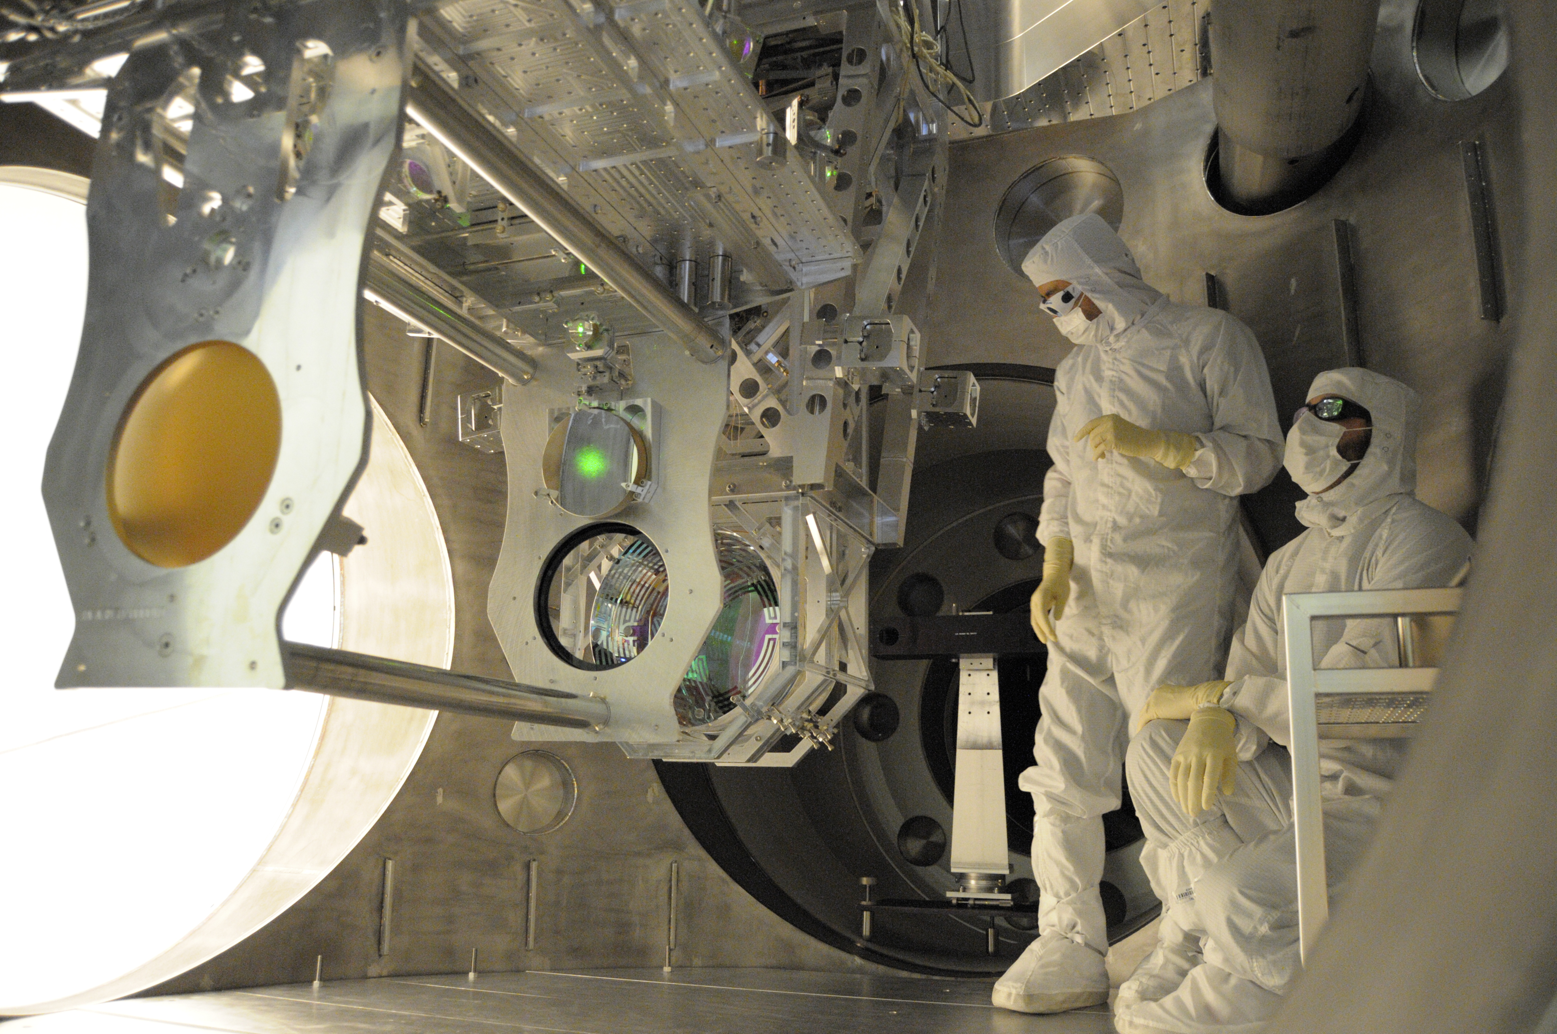
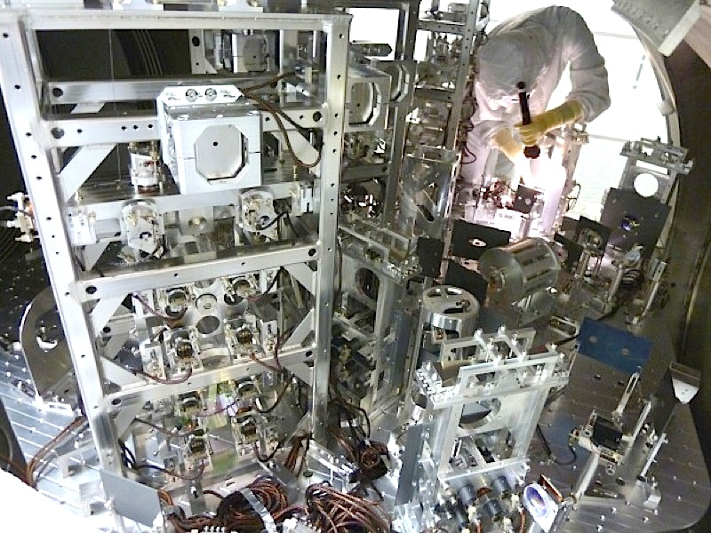
LIGO is Complicated
Notes:
*Sigh* the big guy….things get difficult

Slide 10
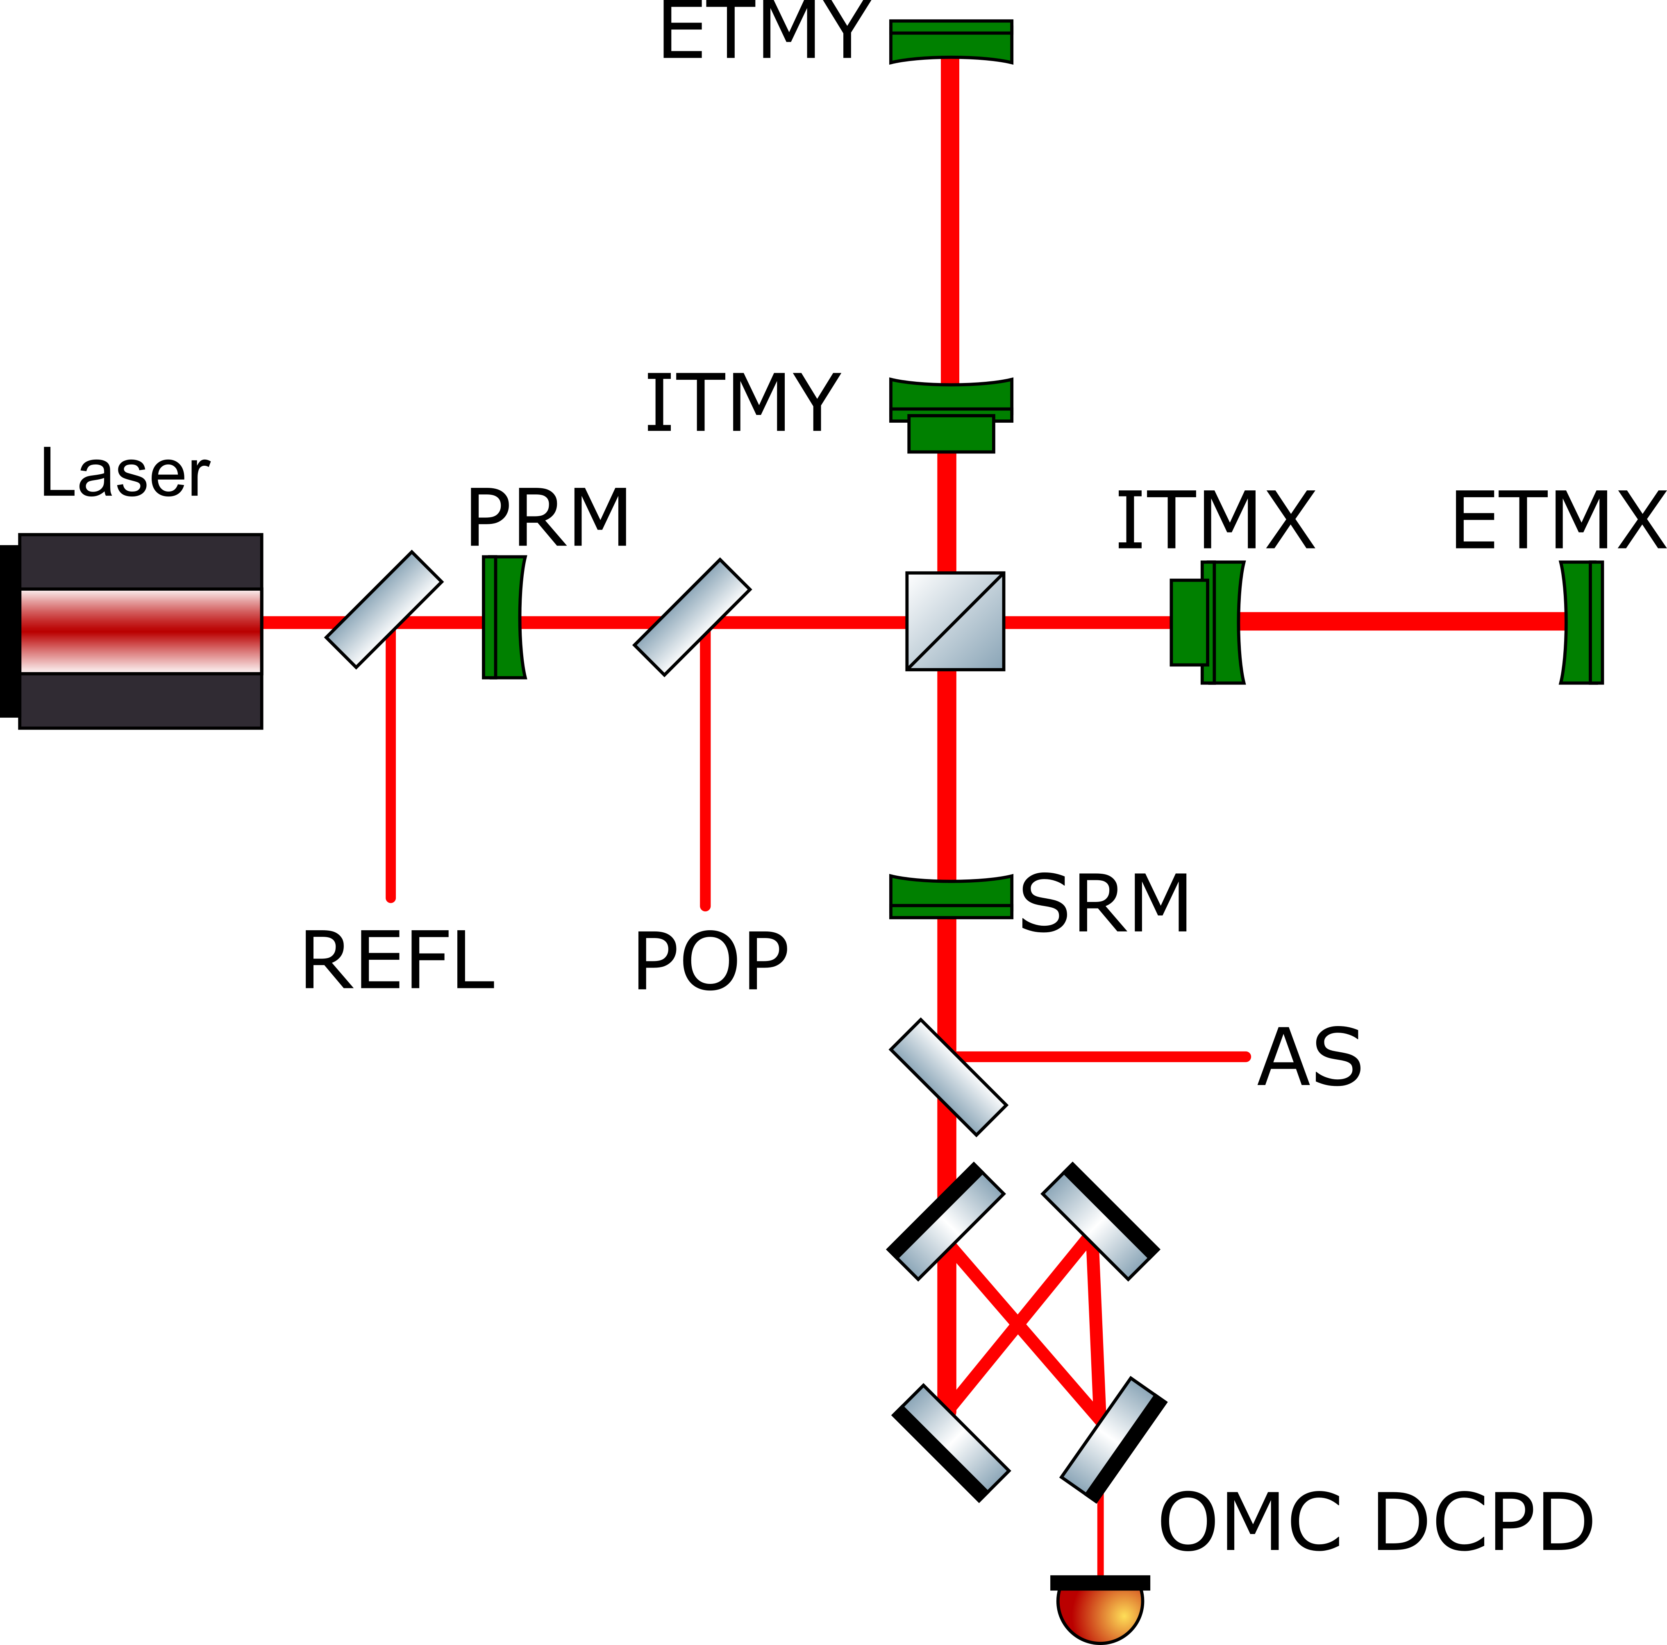
A “Simplified” Diagram
5 degrees of freedom
DARM
CARM
PRCL
SRCL
MICH
Notes:
The laser input is pumped into the interferometer as before and entering the interferometer, the light passes through the beam splitter and into the arm cavities bouncing back and forth hundreds of times, then coming back. But since the anti symmetric port is on dark fringe , most of the power gets reflected, then you put a mirror there to recycle the power. The signal recycling mirror also adds a little gain but mostly changes the response of the interferometer to gravitational waves.
In just length! 5 dofs

Slide 11
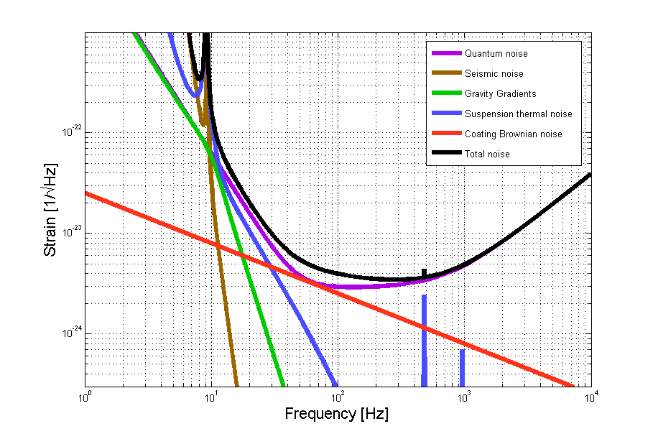
Fundamental Noise in LIGO
Notes:
This is the noise floor of our instrument with frequency on the x axis and strain on the y axis. Frequency, for those unfamiliar is the number of cycles per second, 1 Hz being one cycle per second, 100 Hz being 100 cycles per second.
Noise floor means the best our instrument can do for a given frequency
Lots of noise, lets focus on Quantum Noise

Slide 12
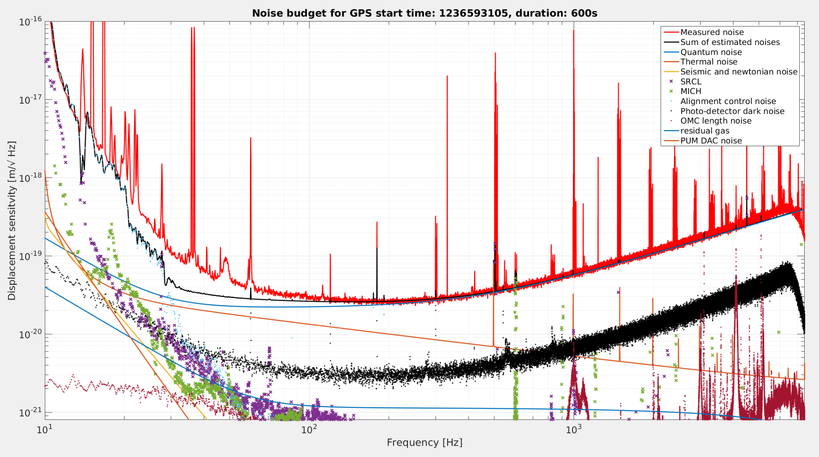
Actual Noise Budget

Slide 13
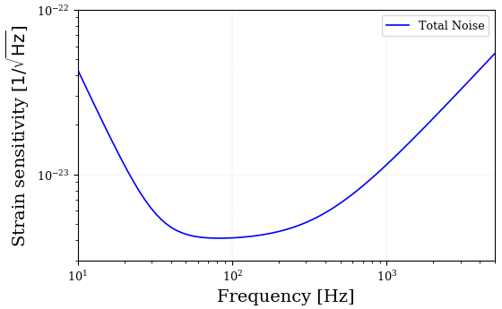
Quantum Limited Sensitivity

Slide 14
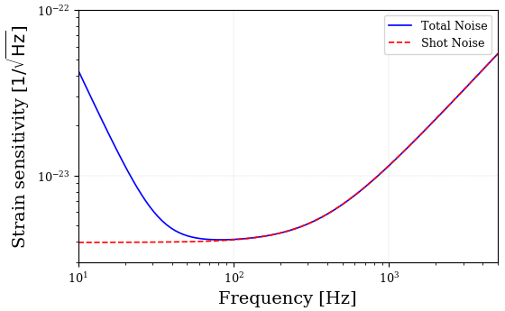
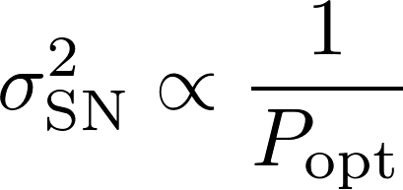
Quantum Limited Sensitivity

Slide 15
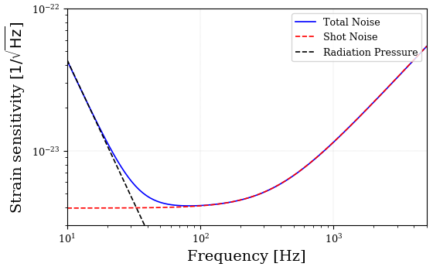
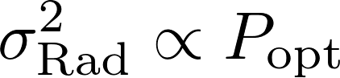
Quantum Limited Sensitivity

Slide 16
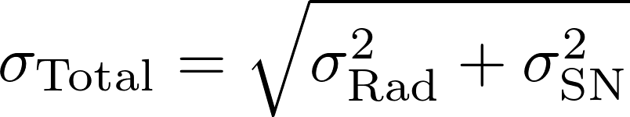
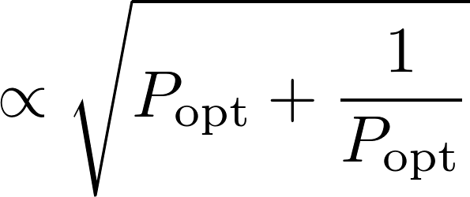
Quantum Limited Sensitivity
Standard quantum limit

Slide 17
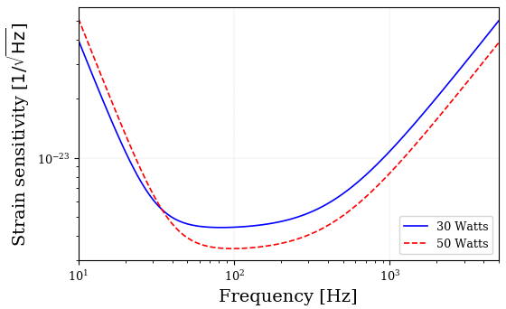
Higher Power
More Radiation Pressure
More Photons
Between 150,000-200,000 Watts in the arm cavities!!!!

Slide 18
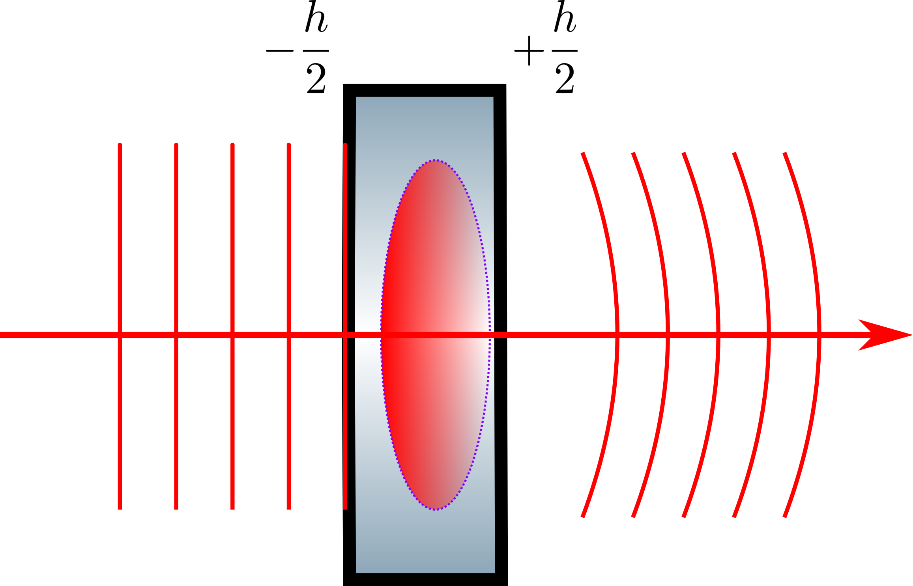
ITM Thermal Lensing
This is where 150-200
kWatts live!
How do we diagnose this problem???

Slide 19
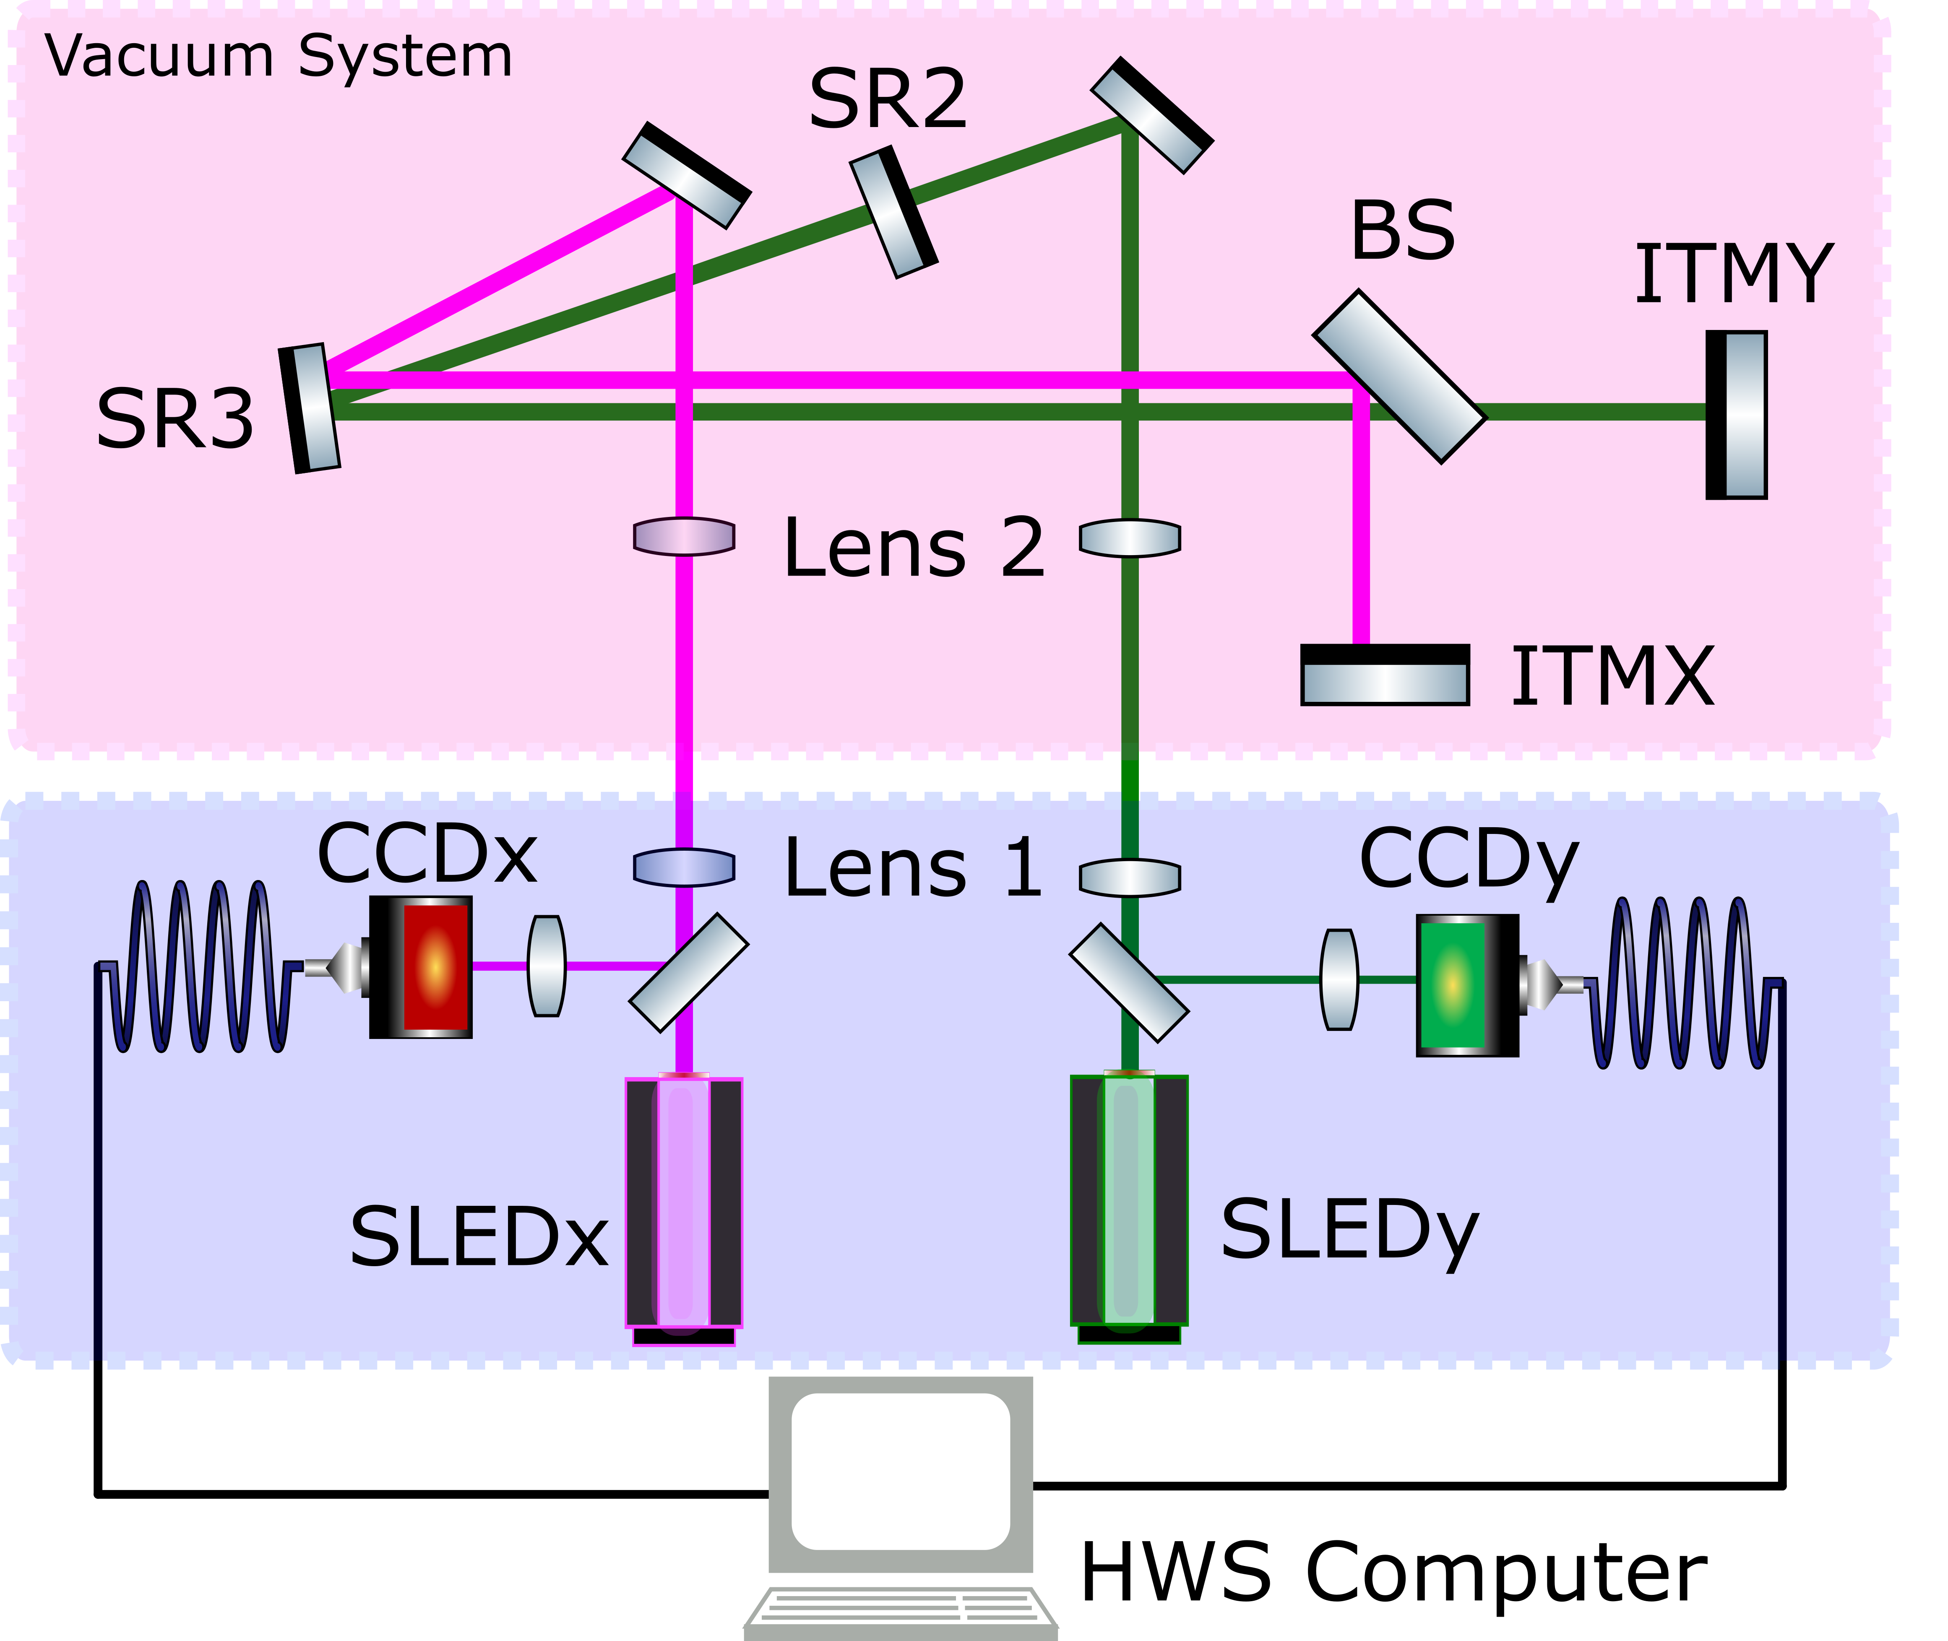
Hartmann Sensors

Slide 20
Hartmann Sensors
Hartmann Plate
CCD

Slide 21
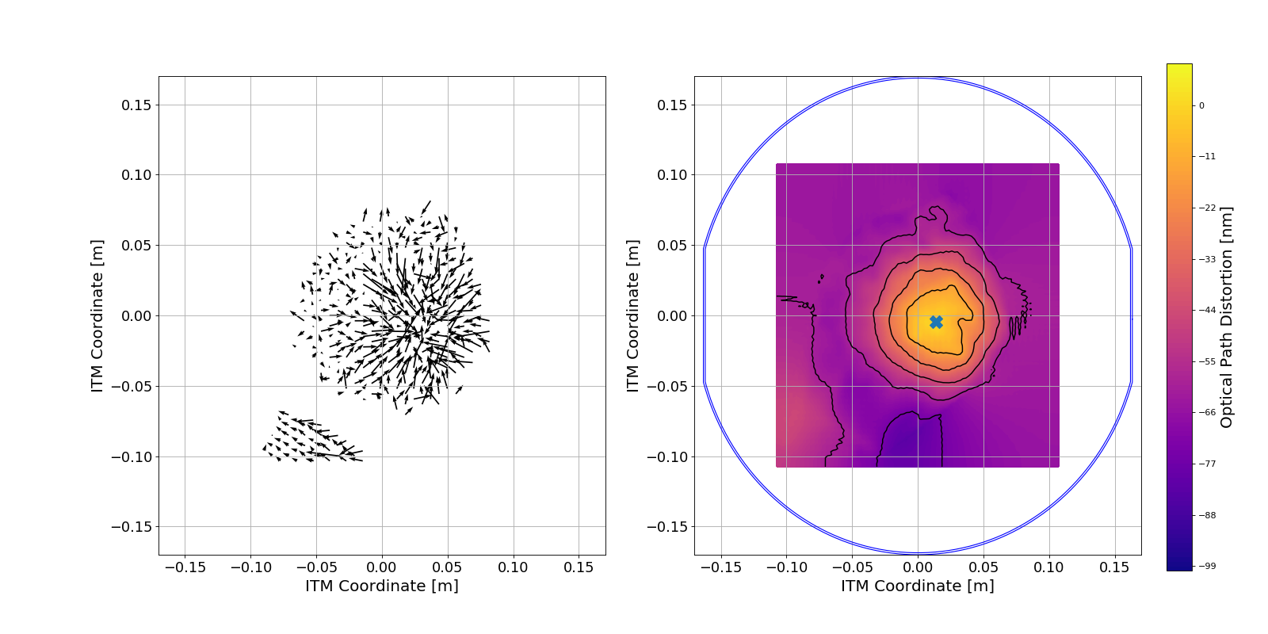
Hartmann Sensor Outputs
ITMX

Slide 22
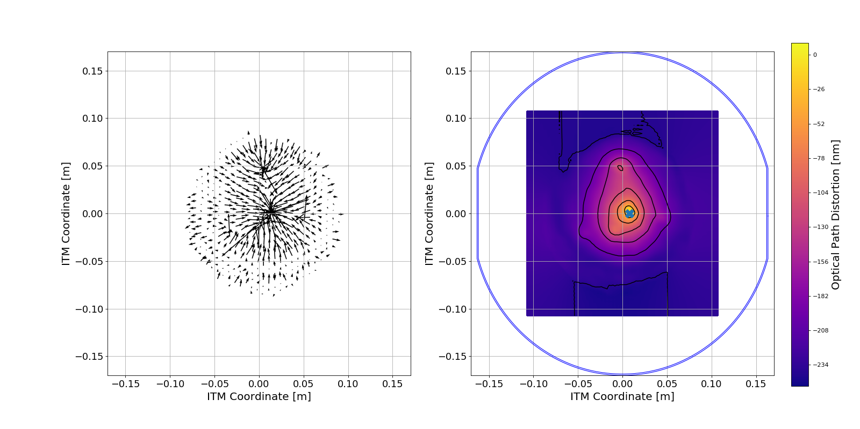
Hartmann Sensor Outputs
ITMY

Slide 23
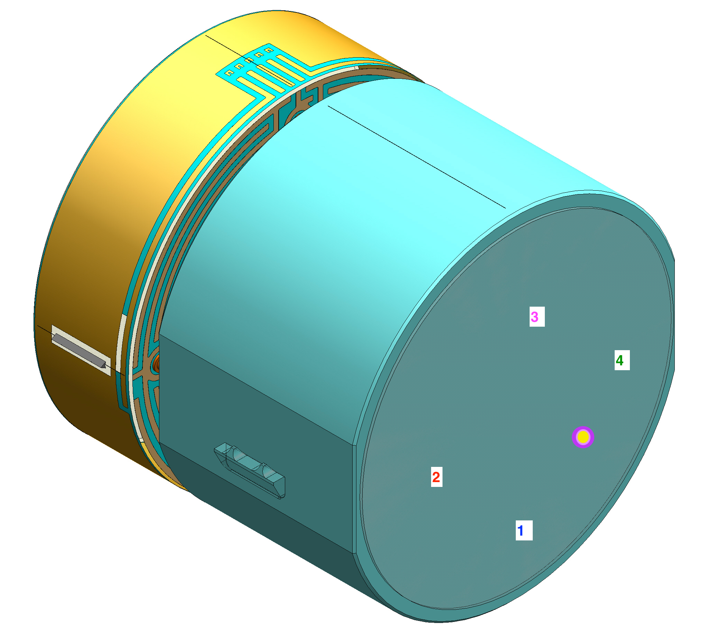
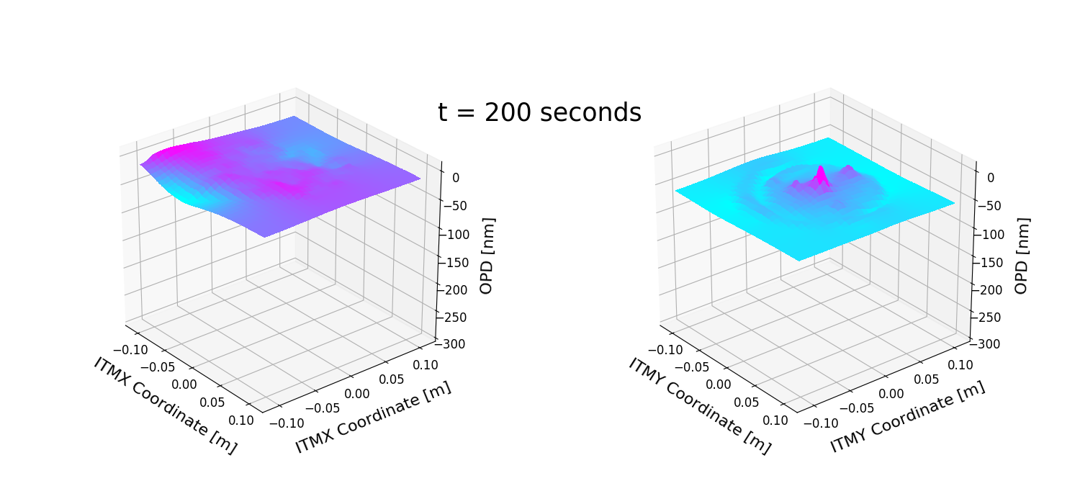
Challenges of High Power
Increased absorption:

Slide 24
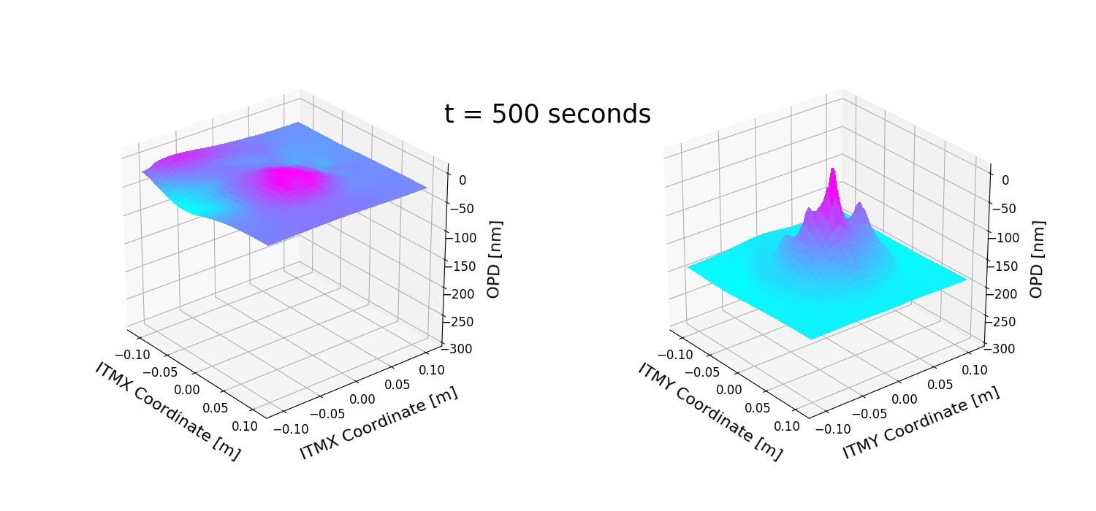
Challenges of High Power
Increased absorption:

Slide 25
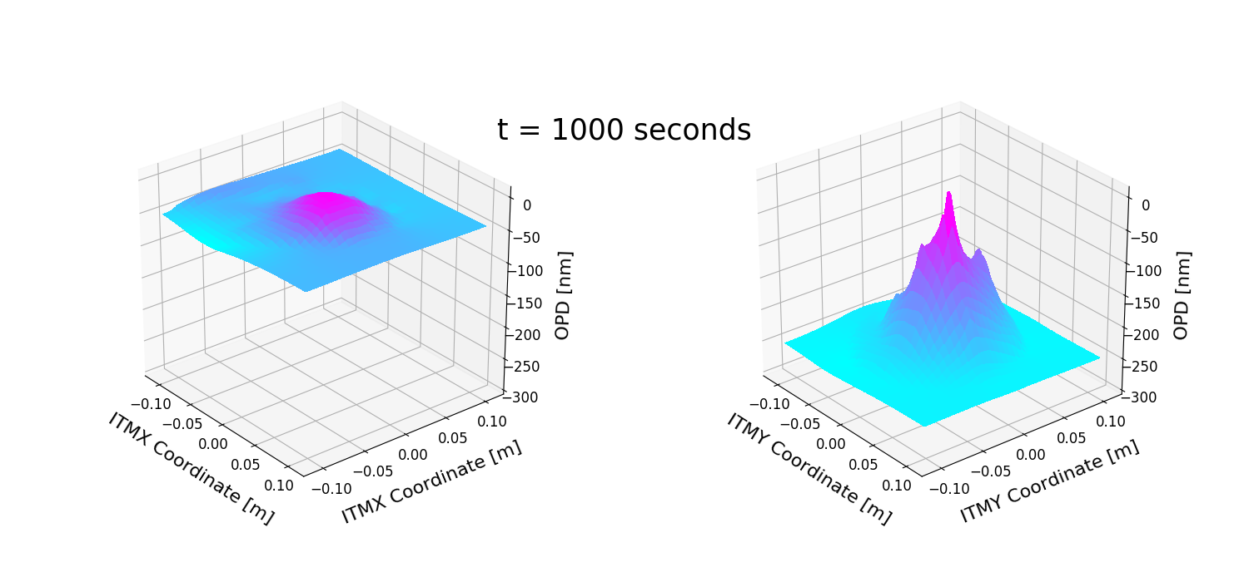
Challenges of High Power
Increased absorption:

Slide 26
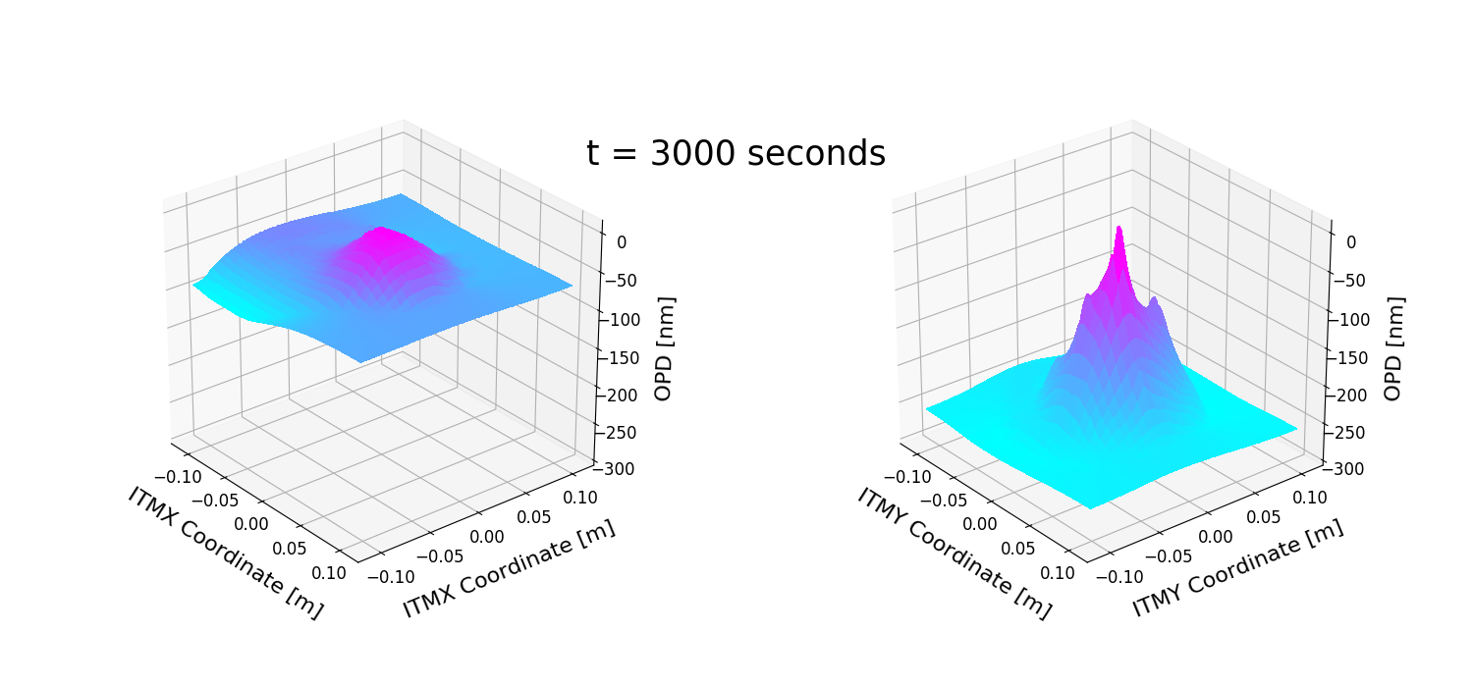
Challenges of High Power
Increased absorption:

Slide 27
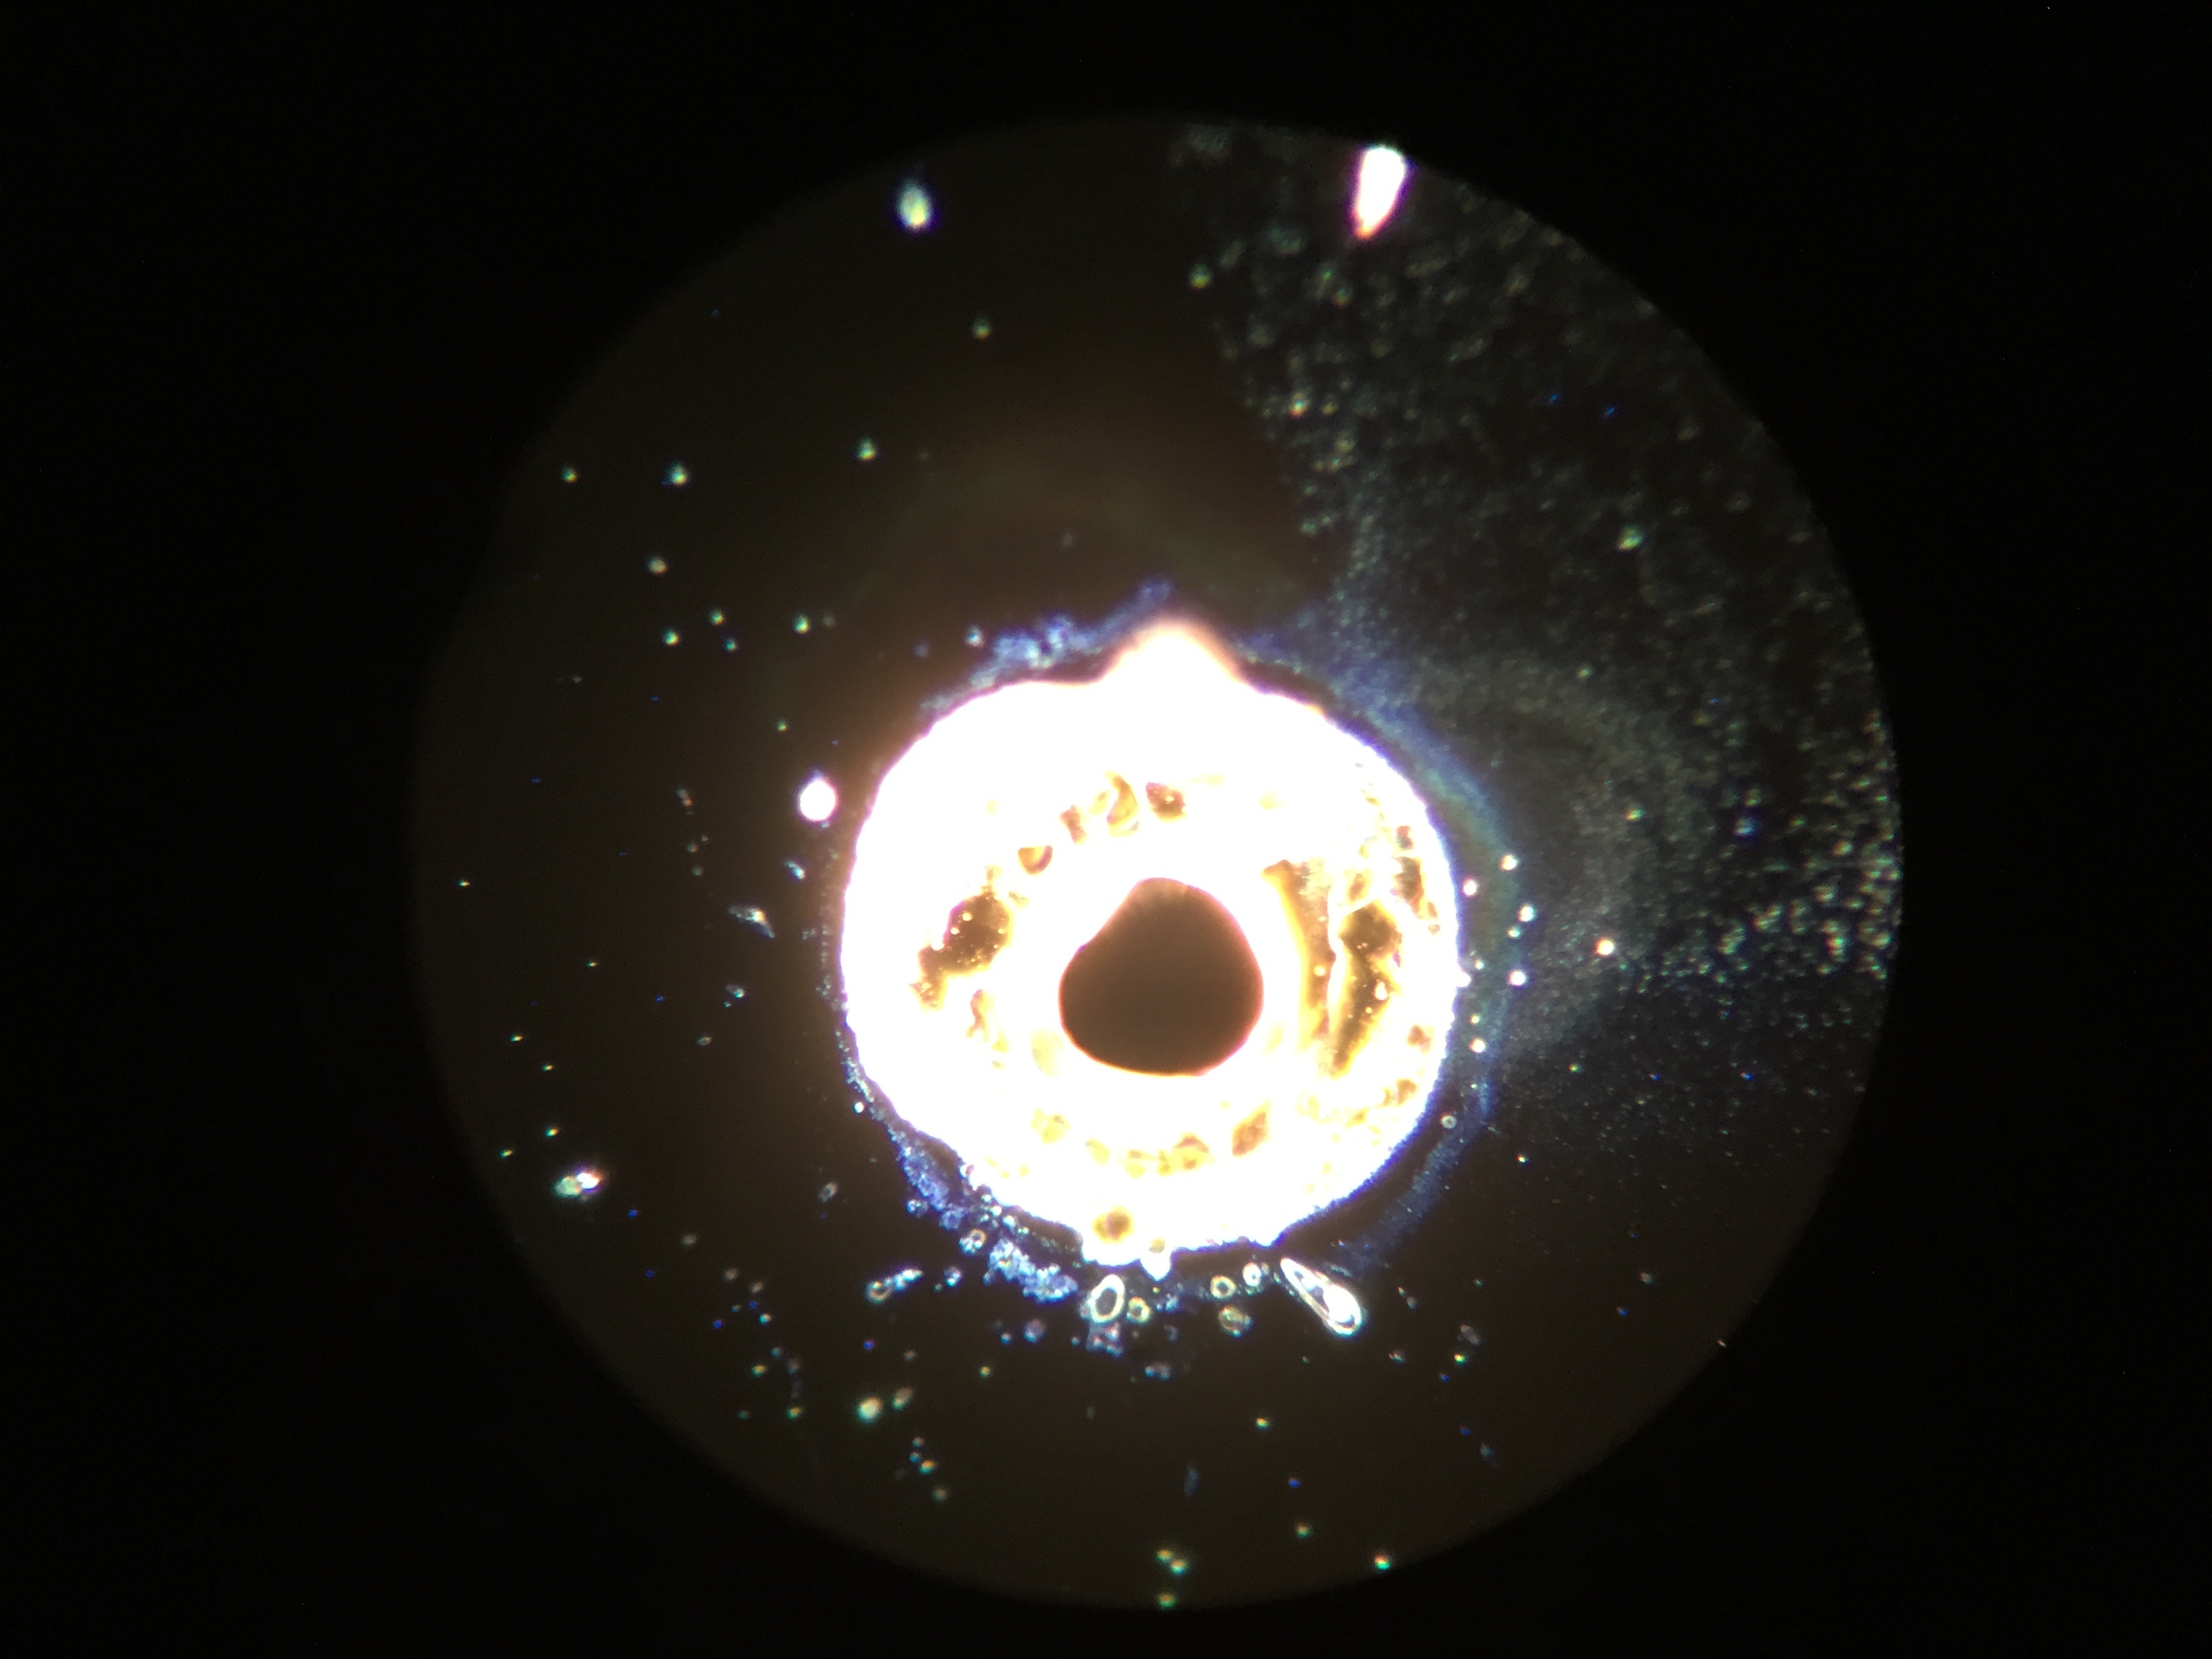
Optic Replacement
In O2 we found a point absorber
So we replaced a bunch of optics!
G. Billingsley G1800345

Slide 28
Why Do We Care?
What are the primary failure points?
What are the effects on noise and performance?
Can we fix it?

Slide 29
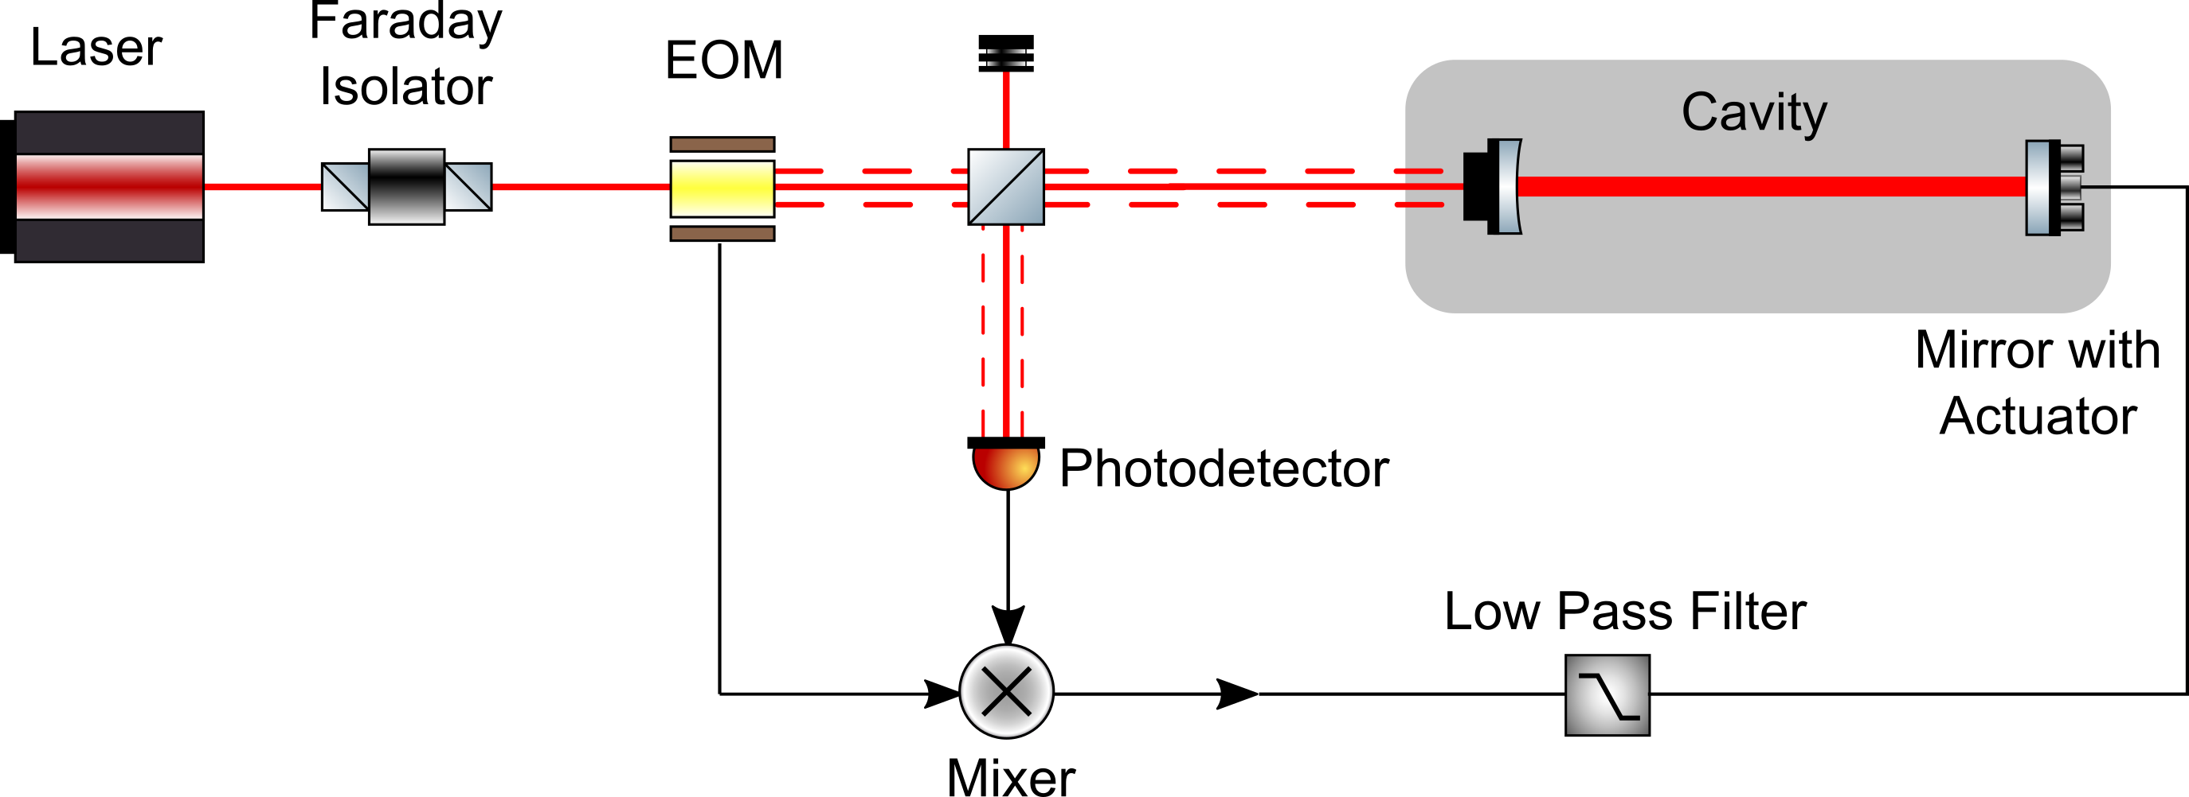
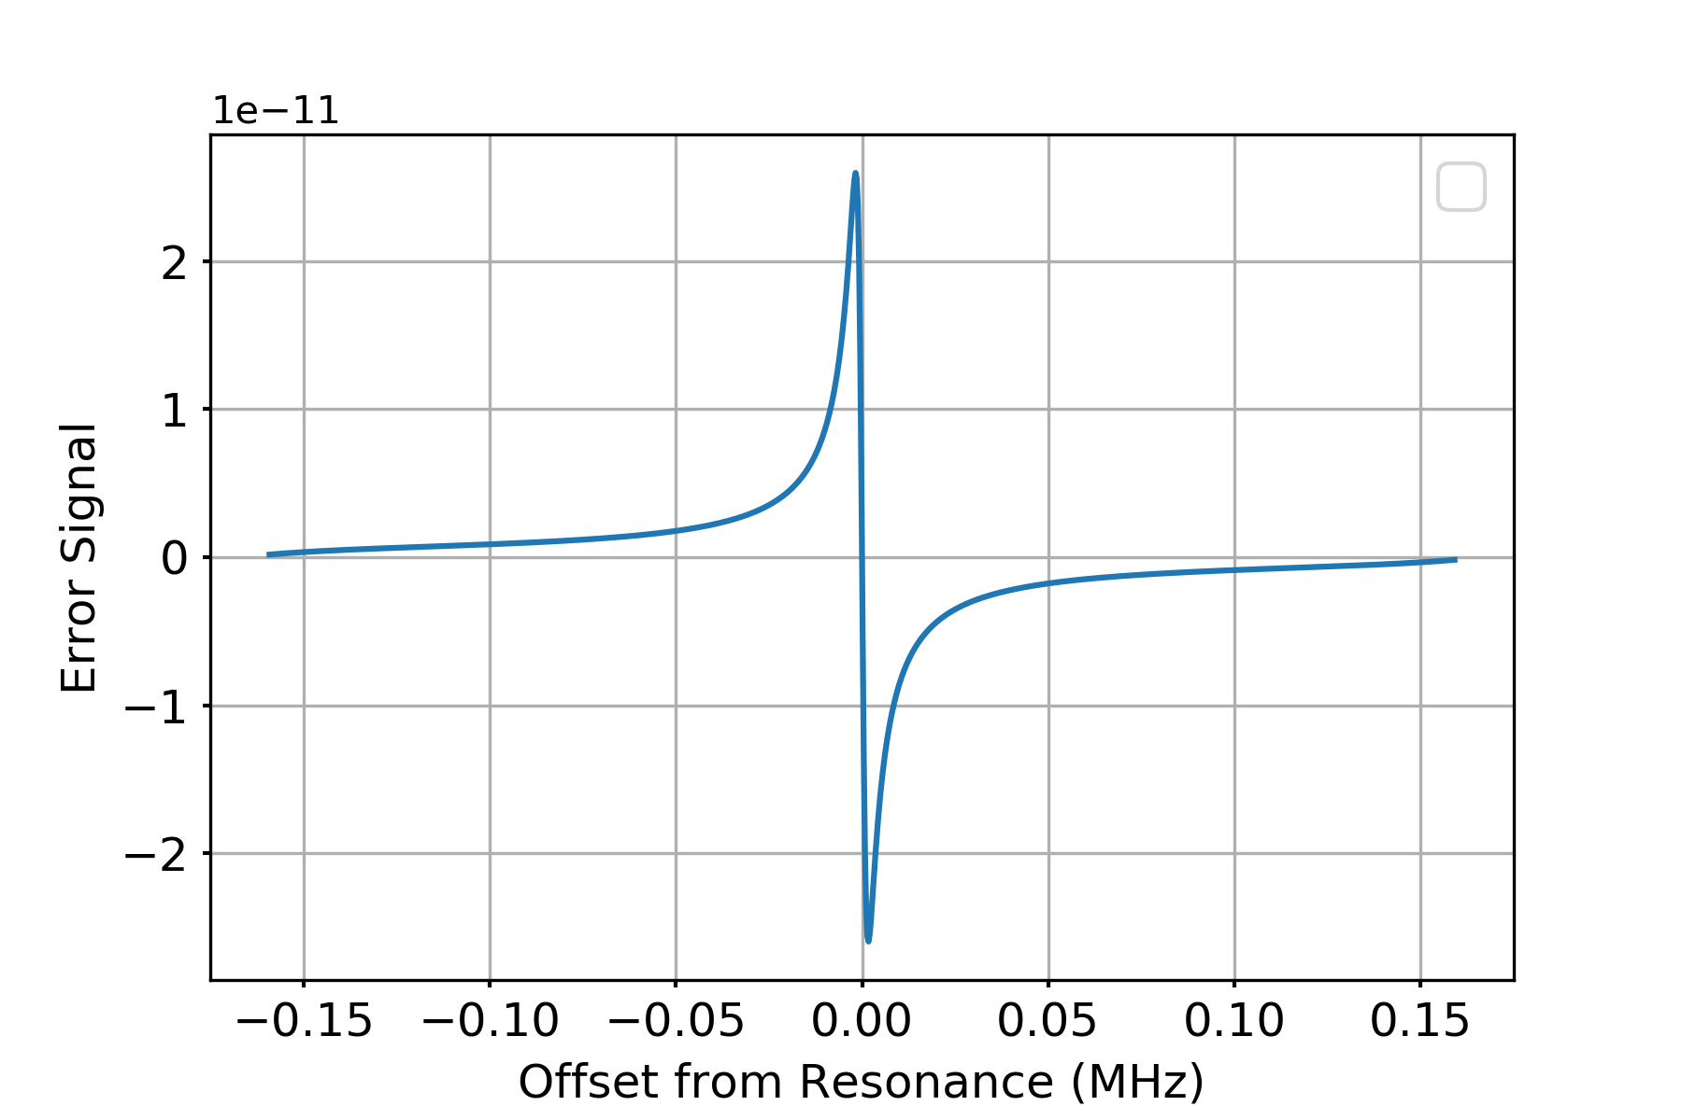
Review PDH Locking
Notes:
One of the first primary failure points, we need to look at how “locking” a cavity works in general.
To lock a cavity, we must control either the frequency or the length of the cavity so that the beam goes back and forth such that it ends up constructively interfering with the previous beam. That way the power builds up more and more each pass, only to be limited by the reflectivity, transmissivity, and loss.

Slide 30
Effect on IFO
Error Signal
PRCL
9 MHz

Slide 31
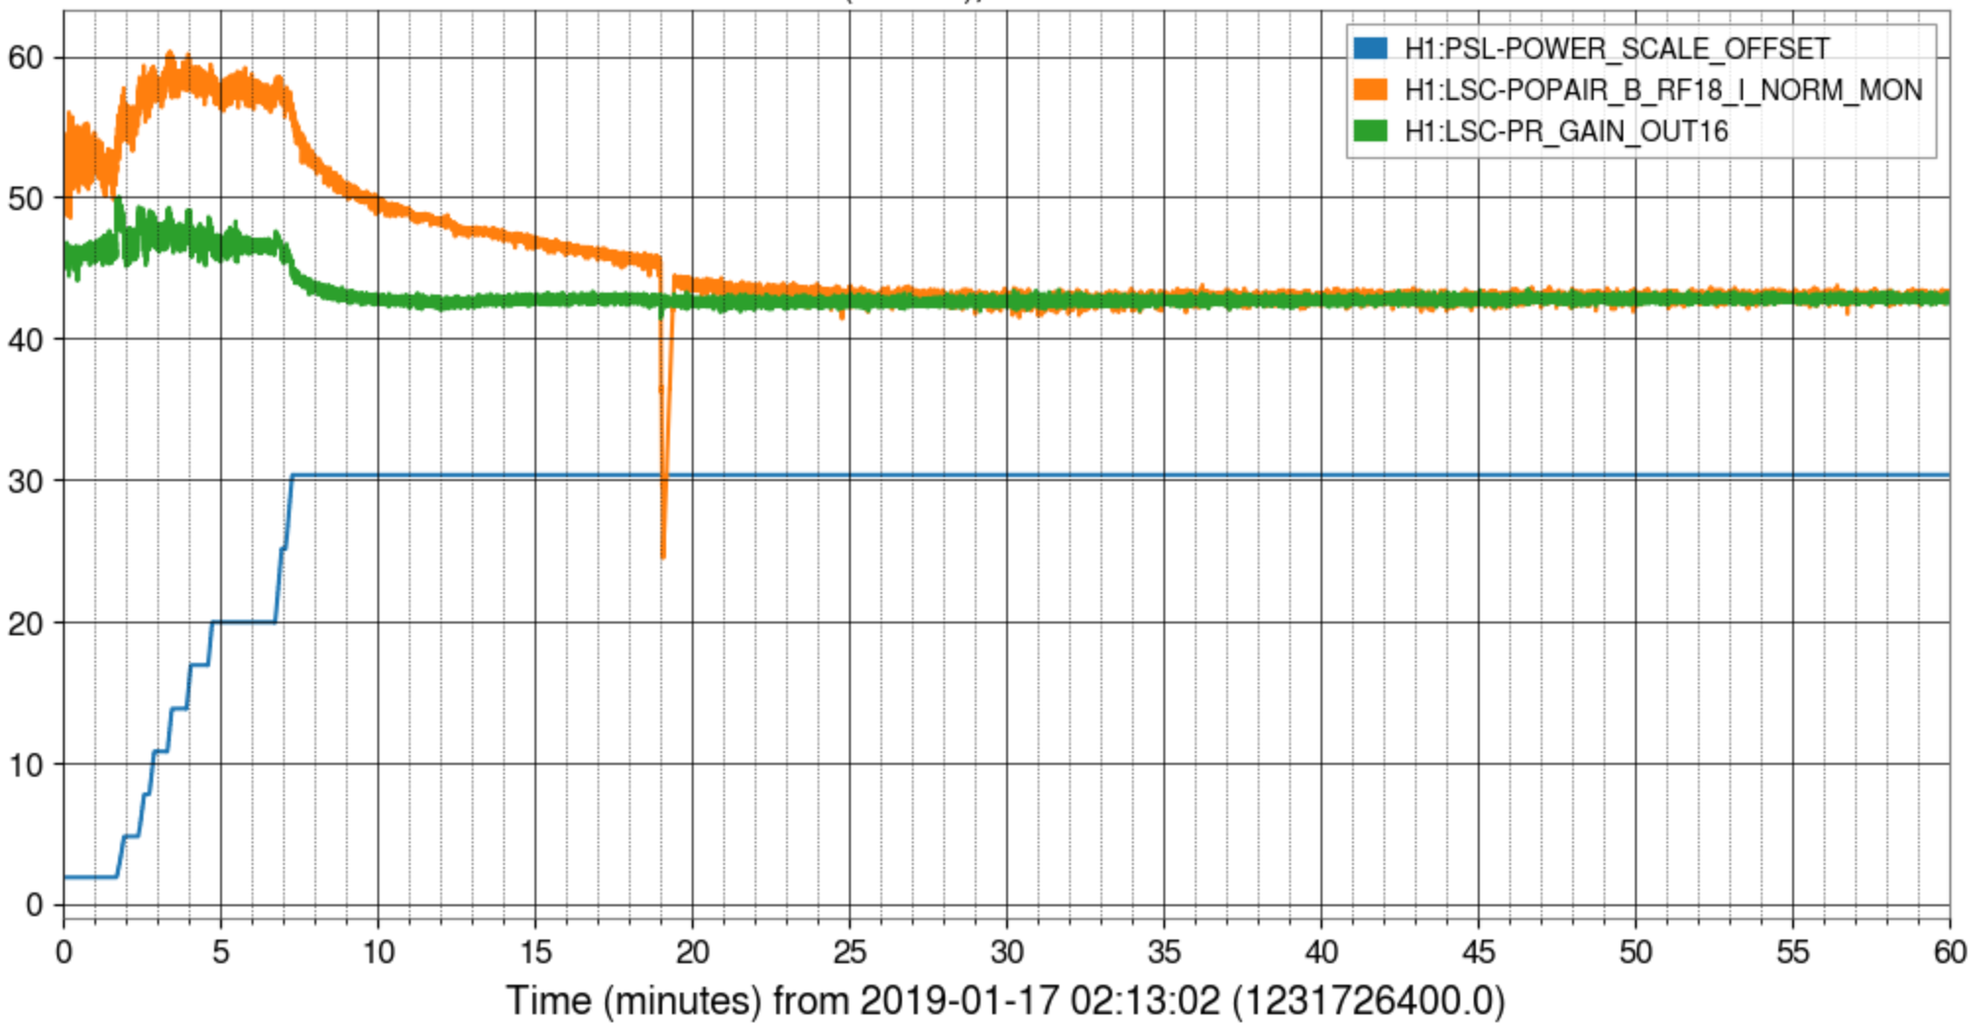
Power Build-Ups
Normalized POP-18 [Counts]
Power Recycling Gain
Input Power [Watts]

Slide 32
Effect on IFO
Error Signal
PRCL
9 MHz

Slide 33
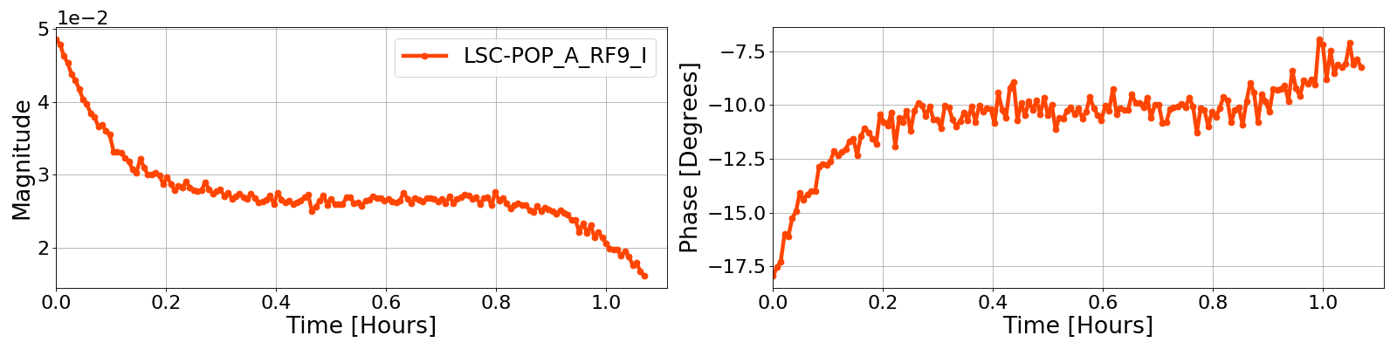
Effect on IFO
Error Signal
Leads to lock losses and makes commissioning much harder.
17 -> 30 Watts was very difficult and time consuming.
20 Watts
30 Watts

Slide 34
Effect on IFO
Diminished Error Signal
Fixed by changing the digital gain, but this is a bandage for the real problem!
20 Watts
30 Watts

Slide 35
Why Do We Care?
What are the primary failure points?
What are the effects on noise and performance?
Can we fix it?

Slide 36
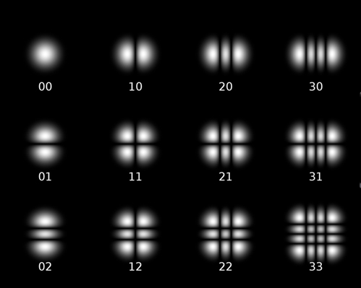
Increased “Junk” Light
9 MHz 9th order coupling.

Slide 37
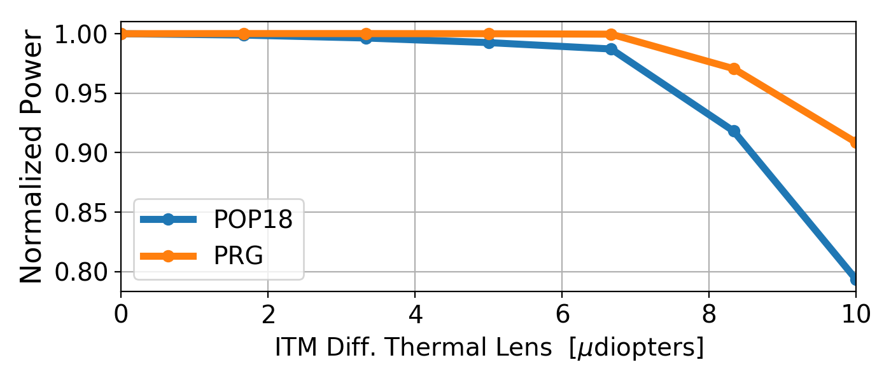
Effect on IFO
What about power recycling?
Measurements indicate a 10% drop in PRG and 410% drop in POP18 with 30 Watts of input power.

Slide 38
Why Do We Care?
What are the primary failure points?
What are the effects on noise and performance?
Can we fix it?

Slide 39
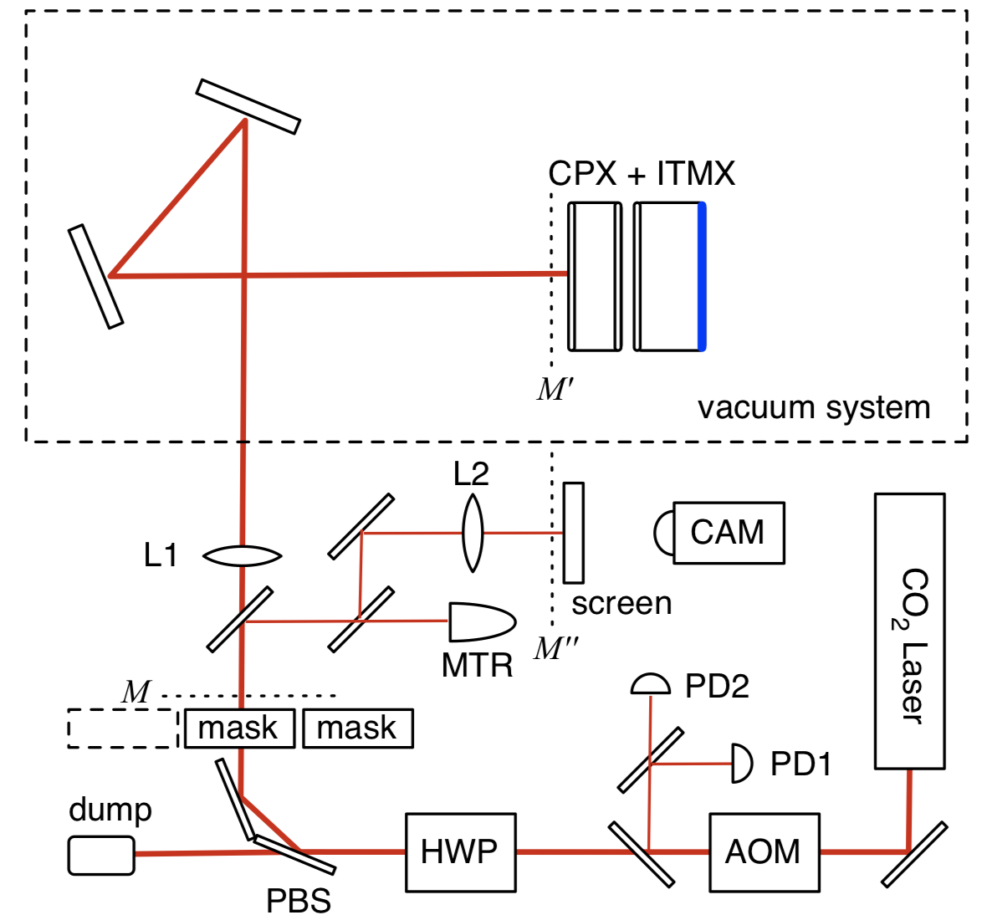
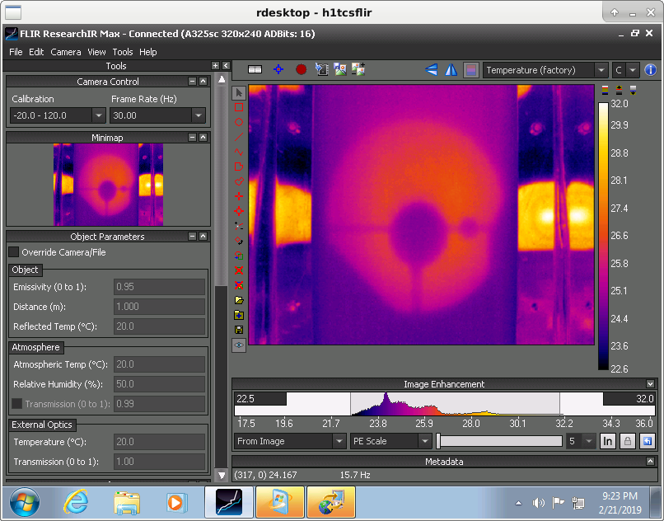
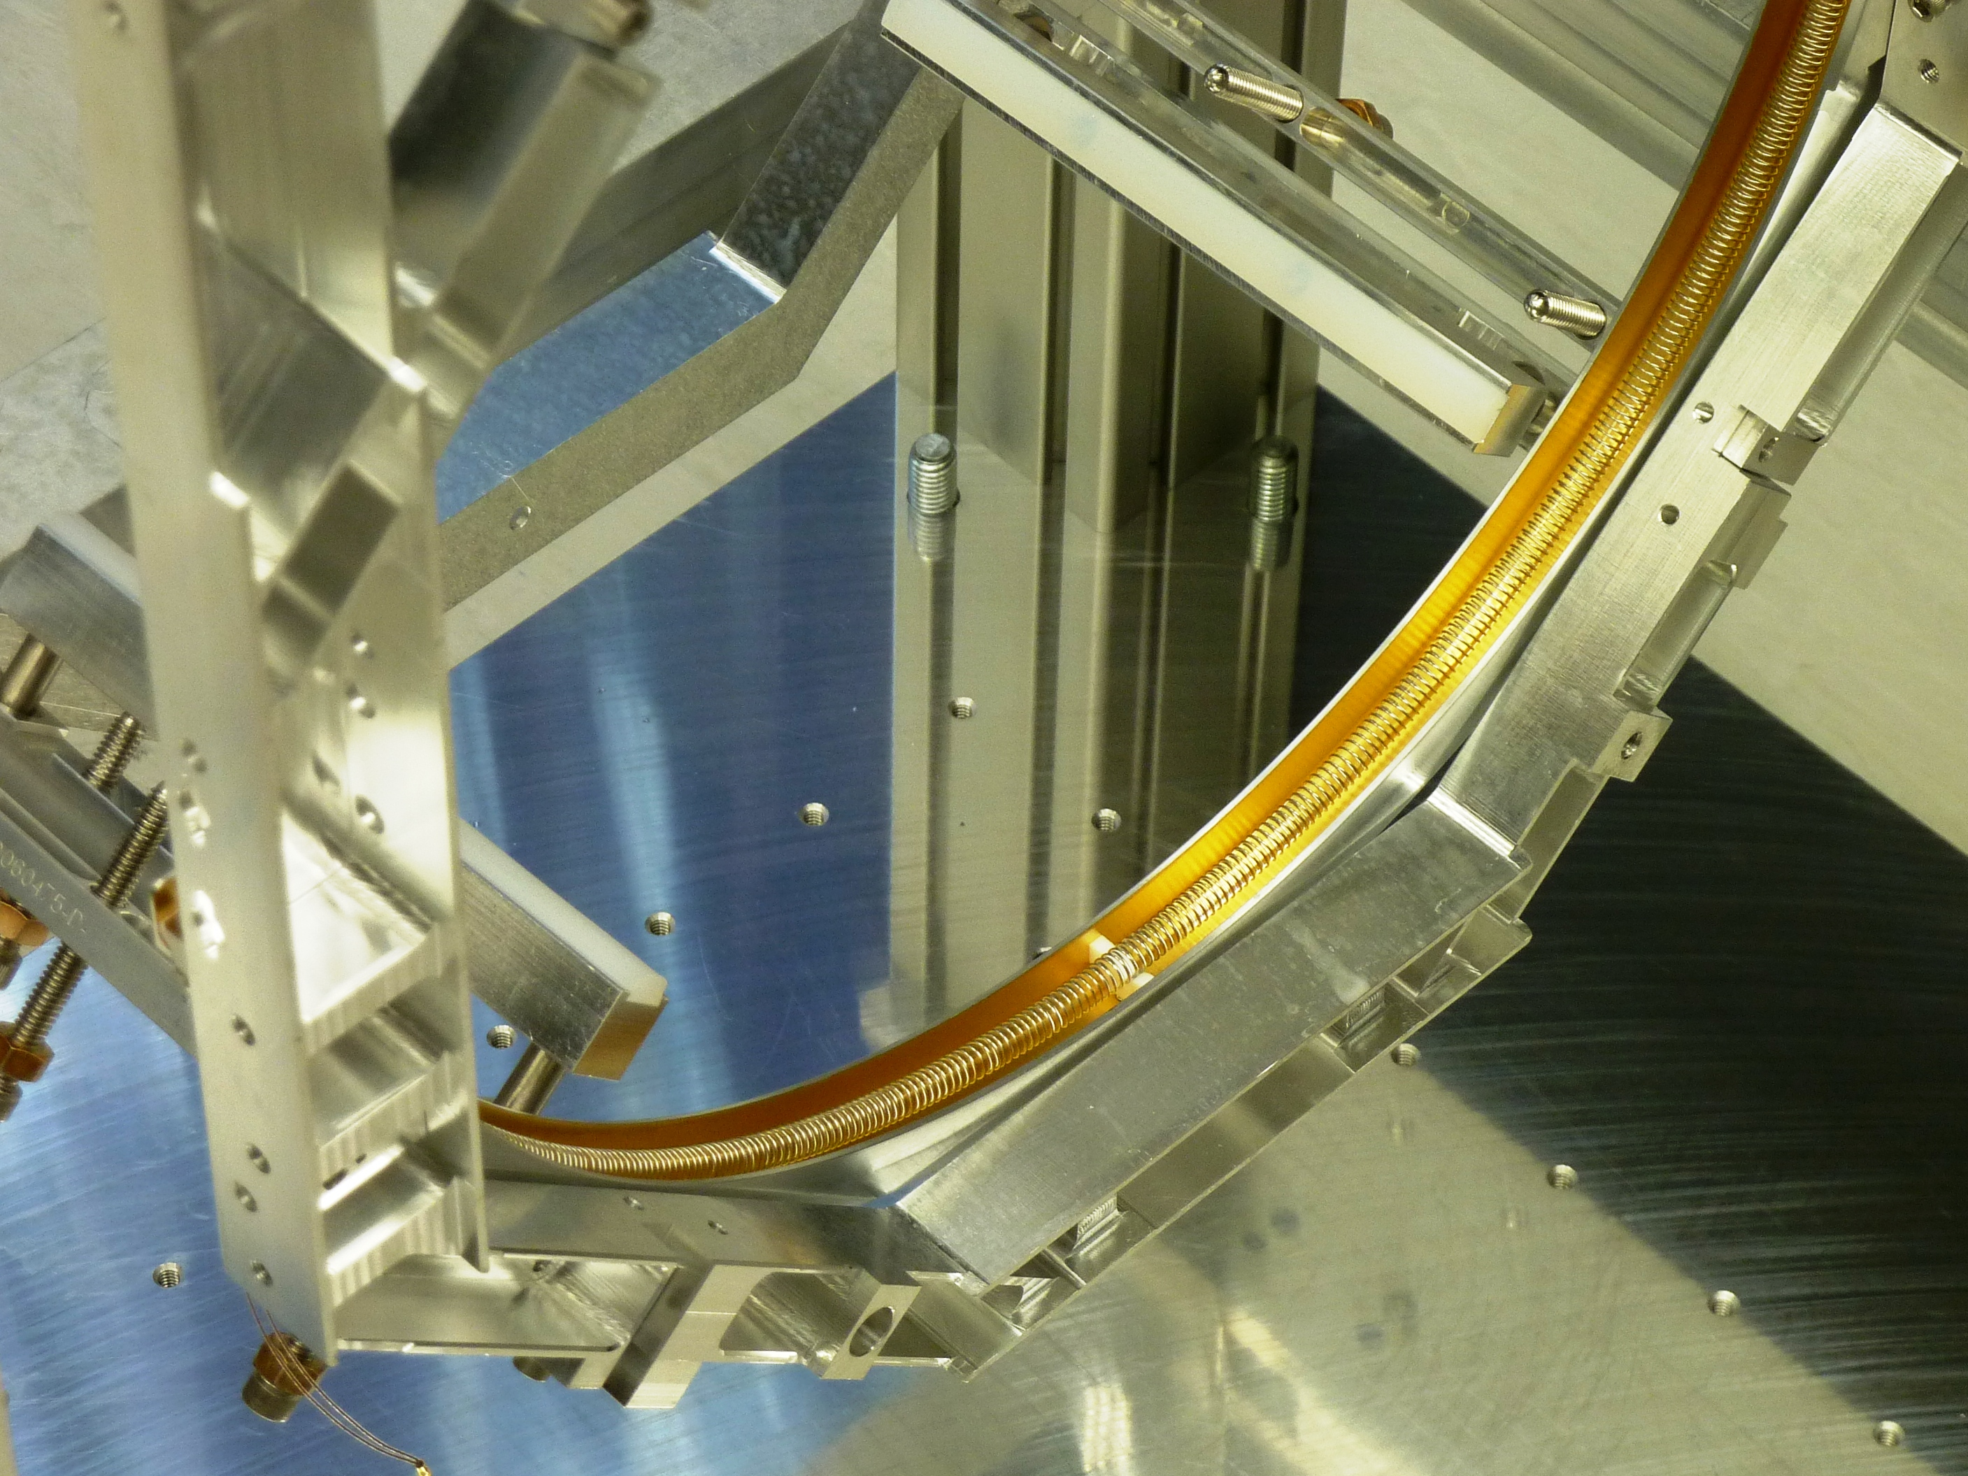
Thermal Compensation
CO2 lasers
Ring Heaters

Slide 40
Move the spot positions?
Best option so far but limited in range.

Slide 41
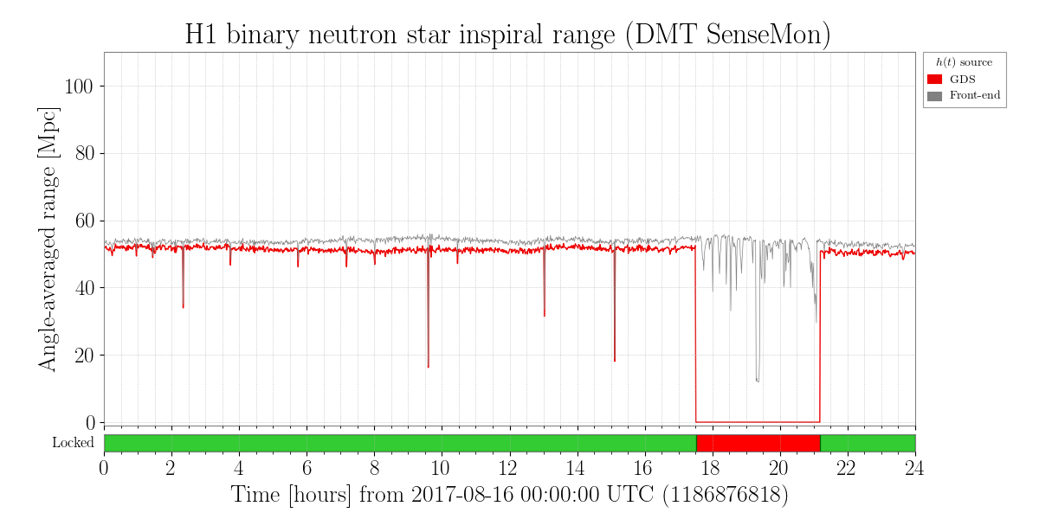
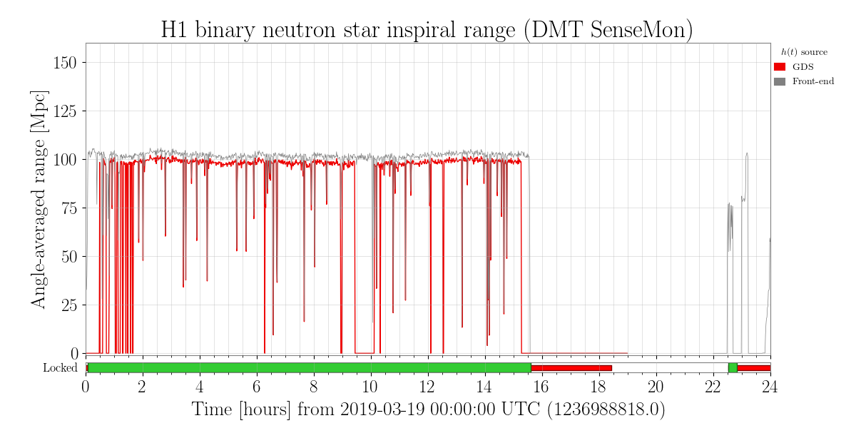
Hanford in the End….
Stable operation at 30-35 Watts of input power
At least 50% more circulating arm power than O2.
~ 105 Mpc planned for operation
Almost 50% extra range for binary neutron star inspirals than O2.

Slide 42
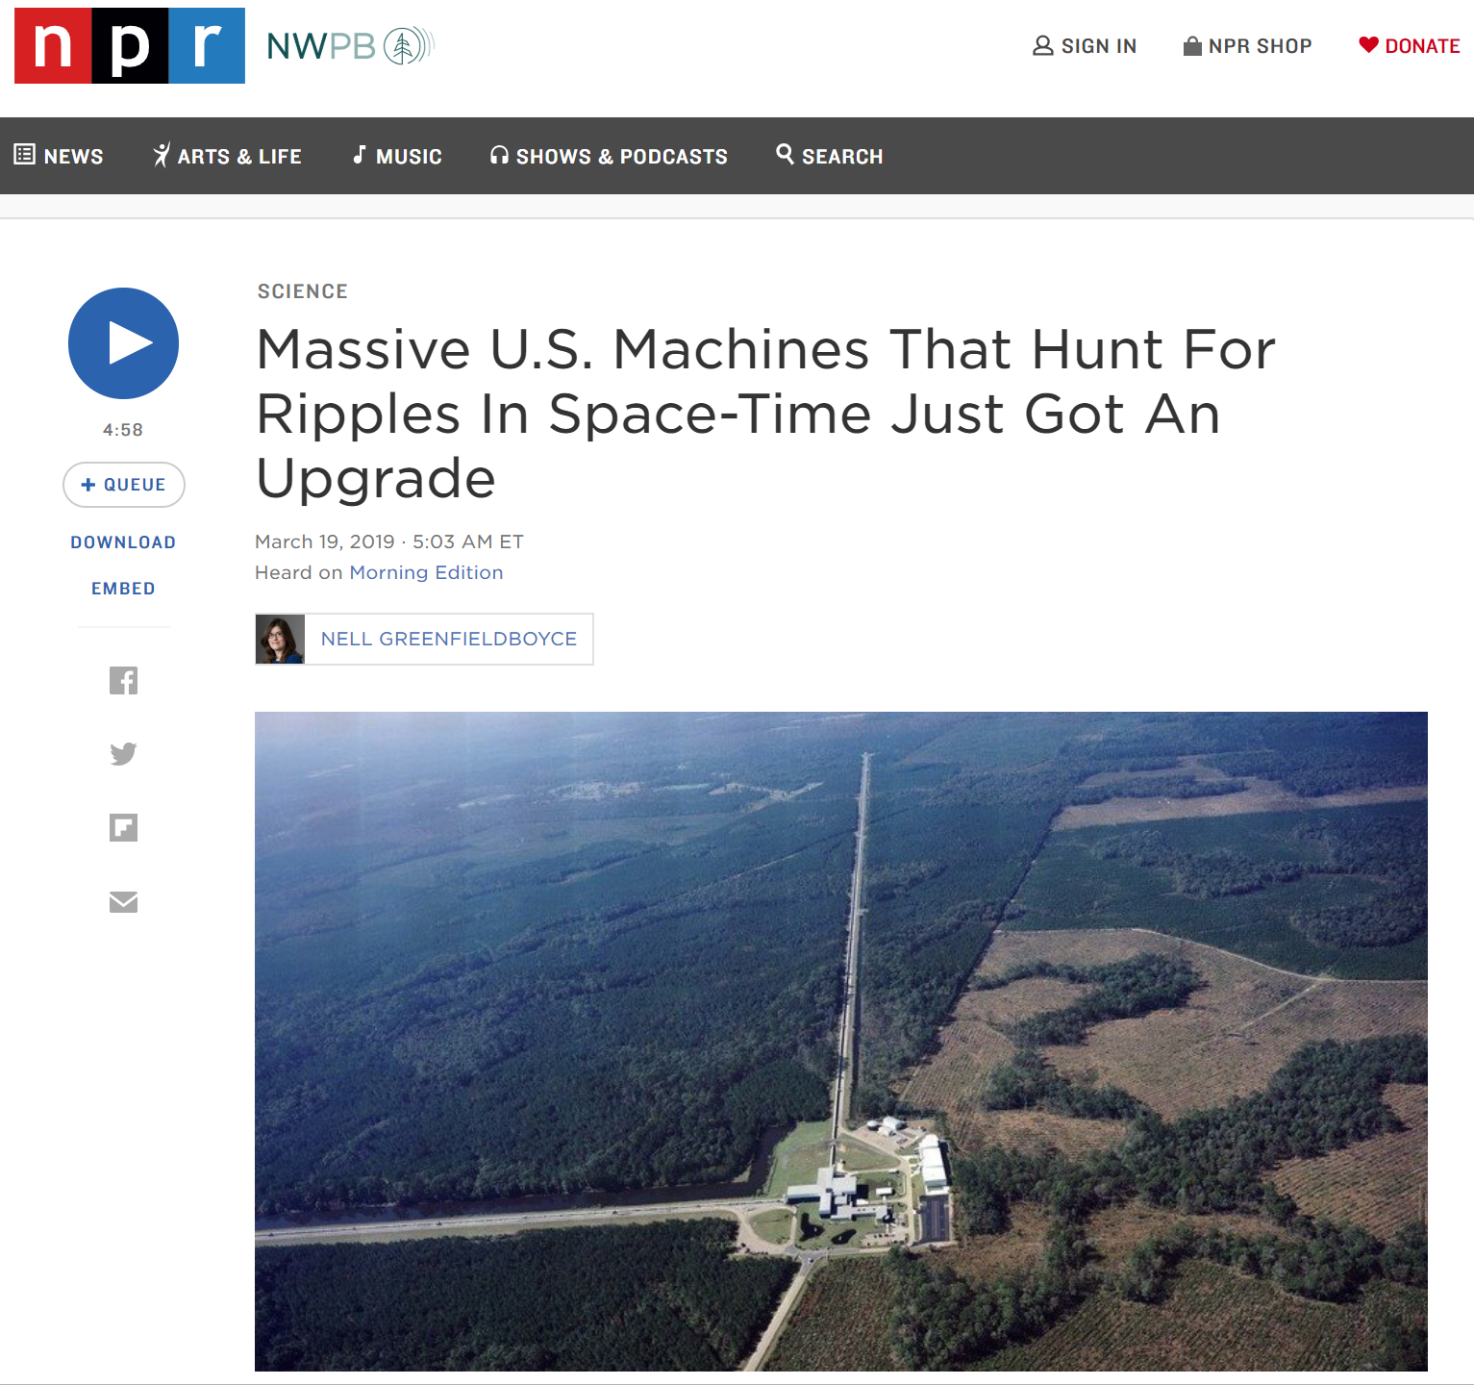
In the Media
“On April 1, the twin facilities in Louisiana and Washington state that make up the Laser Interferometer Gravitational-Wave Observatory will start doing science again after being shut down for more than a year so that workers could install hardware upgrades.”

Slide 43
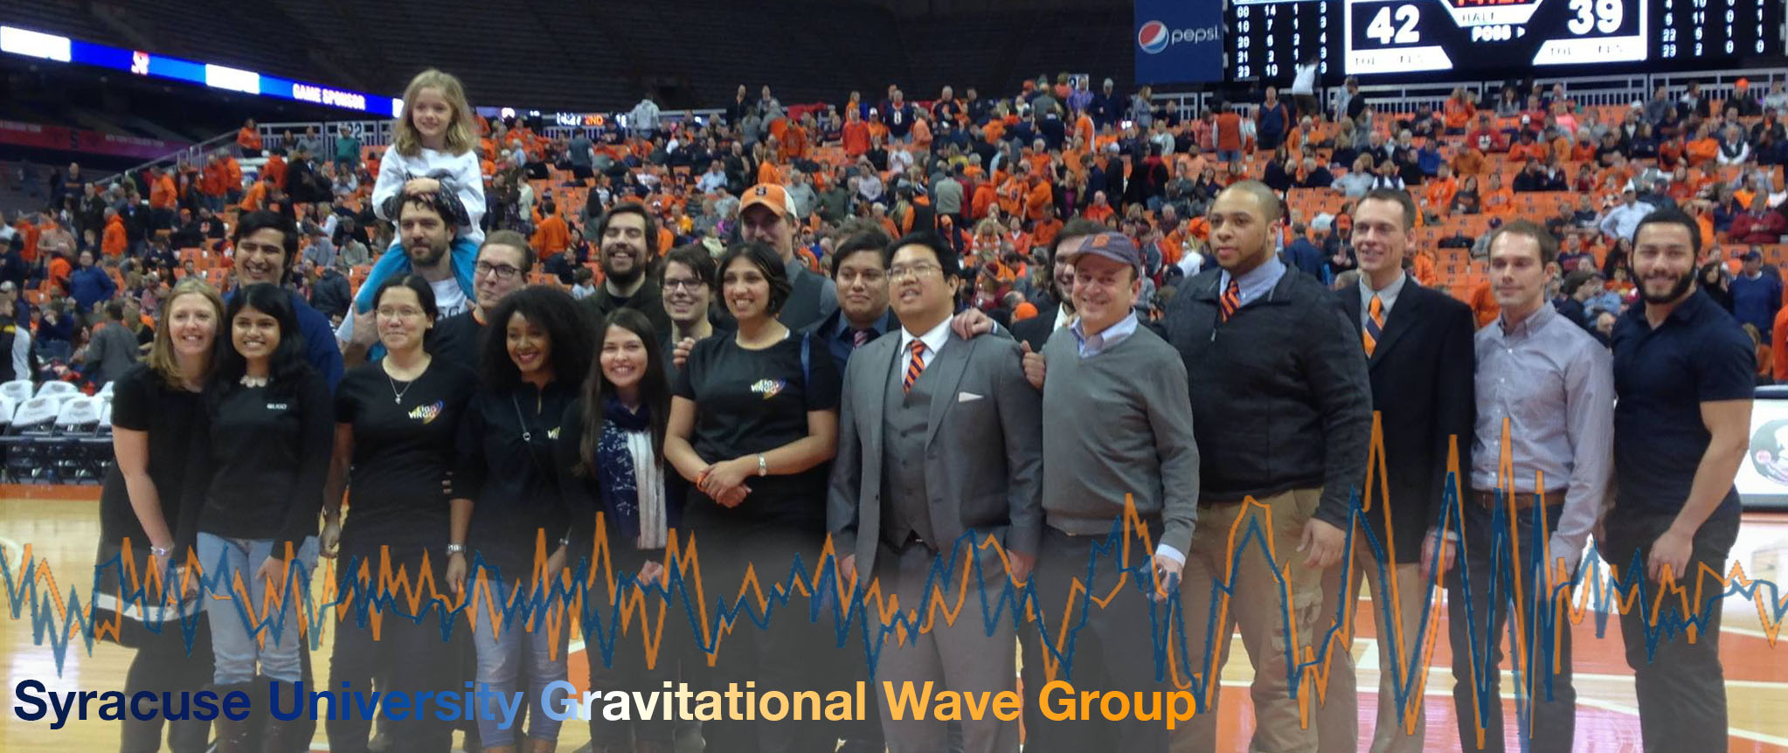
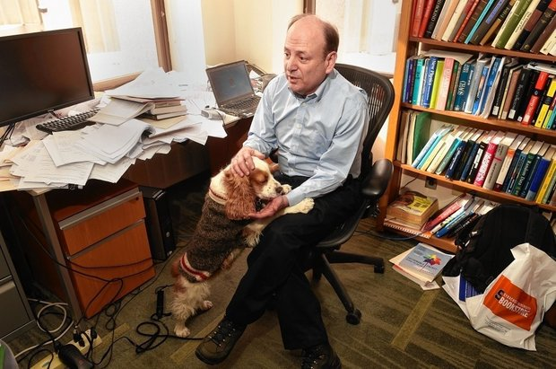








Thank You

Slide 44

Wavefront Distortion from a Laser
A Laser beam imparts energy onto the surface of the test mass.
Changes the temperature field
Temperature field changes the index of refraction
Power coming in!
Power Escaping!

Slide 45
Wavefront Distortion from a Laser
A Laser beam imparts energy onto the surface of the test mass
Changes the temperature field
Temperature field changes the index of refraction

Slide 46

Wavefront Distortion from a Laser
A Laser beam imparts energy onto the surface of the test mass
Changes the temperature field
Temperature field changes the index of refraction
Index of refraction changes the wavefront -> optical path distortion
ACTS LIKE A LENS!!!

Slide 47


GW Signal

Slide 48



Common Lens Effect on the Carrier

Slide 49

Common Lens Effect on the Carrier

Slide 50

Common Lens Effect on the Carrier

Slide 51

Common Lens Effect on the Carrier

Slide 52
Early Detection Methods
We found the point absorber 4 months into commissioning.
Required locking the interferometer in length and angular.
Then powering up to at least 15 Watts of input power.
Possibly for the future, re-arranging the commissioning schedule to specifically look for point absorbers.
The Hartmann Sensors require about 75 kW of circulating power.

Slide 53

Measures Defocus!
Nominal Lensing
Bad focusing

Slide 54
Early Detection Methods
Lock single arms with power recycling and max input power.
Easier and faster.
Can be done one arm at a time.

